Slide 1
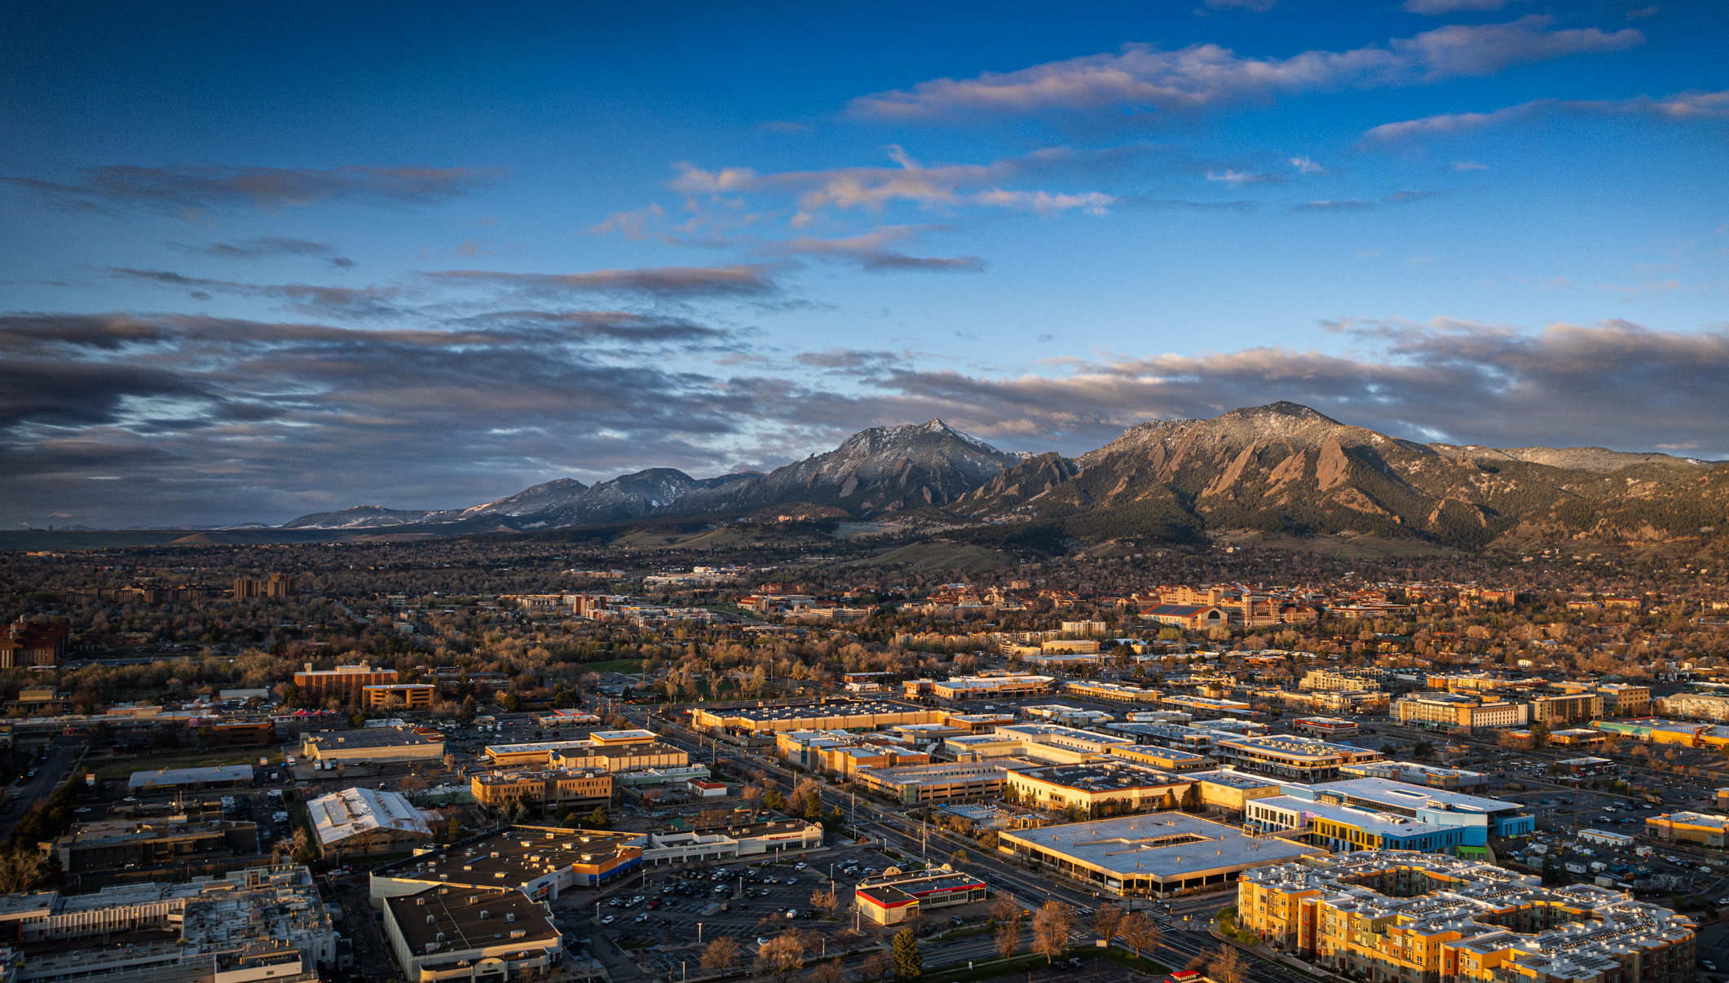
PREPAREDNESS BASICS
Disaster Strong Series

Slide 2
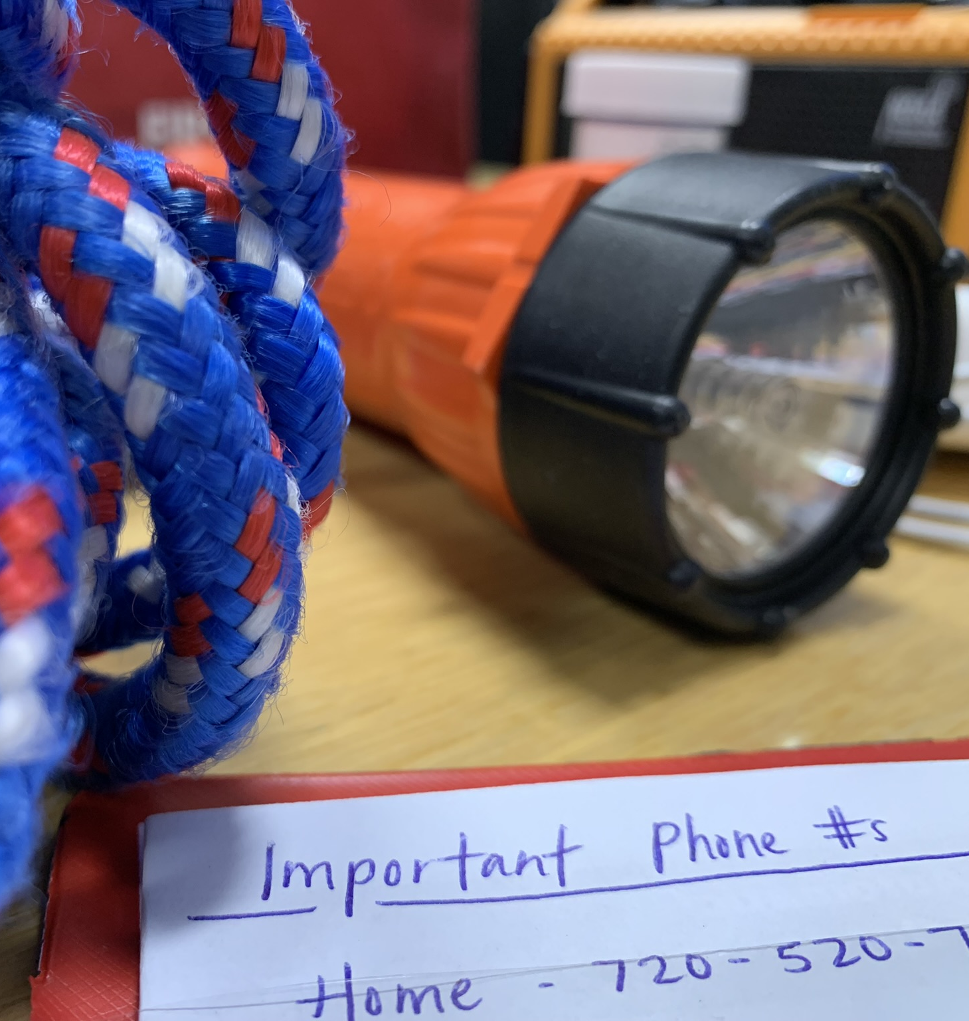
Overview
Boulder County Hazard Profile
Alert and Warning
Assessing Your Risk
Making a Plan
And the most impotant thing: the audience won’t miss the point of your presentation

Slide 3
Boulder County Hazard Profile

Slide 4
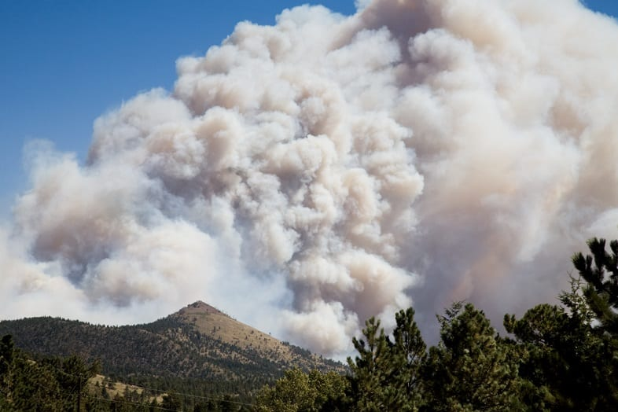
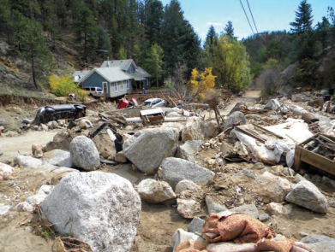
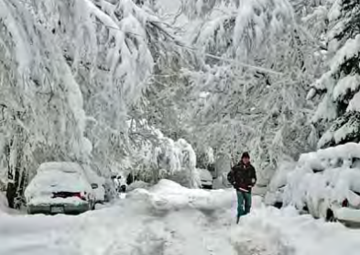
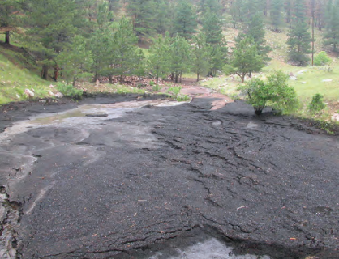
The History of Disasters in Boulder County
Introduction of terminology
Disaster
Emergency
Disaster history
And the most impotant thing: the audience won’t miss the point of your presentation

Slide 5
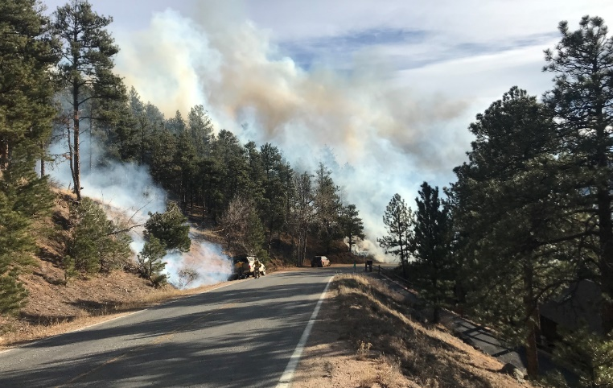
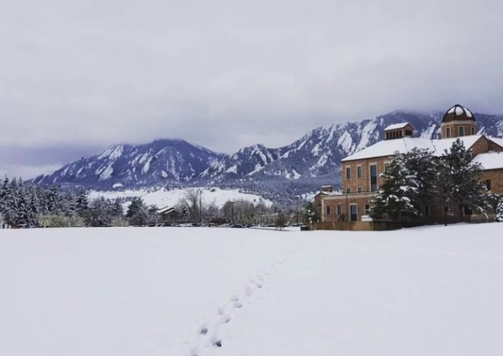
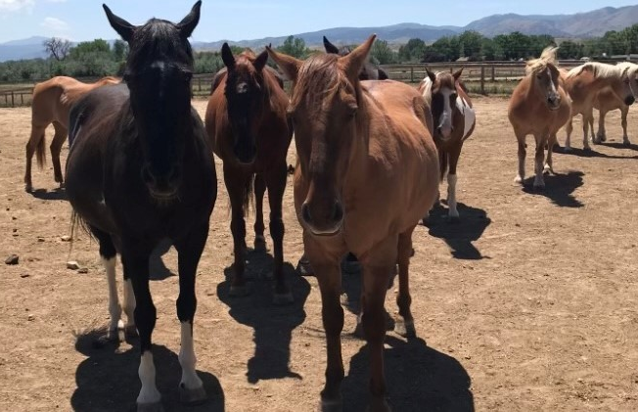
Top 5 Risks (2023)
Wildfire
Communicable Disease/Zoonotic Outbreak
Flood
Winter Storm
Extreme Temperatures
And the most impotant thing: the audience won’t miss the point of your presentation

Slide 6
Emergency Alerts

Slide 7
How do you typically get information emergencies or disasters?

Slide 8
Types of Notification
You
Neighbors/friends
Everbridge Opt-In Alerts
ReachWell Translation App
Wireless Emergency Alert (WEA)
Emergency Alert System (EAS)
NOAA All-Hazards Weather Radio
Sirens
Door to door
Social media

Slide 9
Everbridge Opt-In Alerts
Types
Call
Text
E-mail
Manage your account
Add up to 5 addresses
You will only get notifications for impacted areas near one of the addresses affiliated with your account.
And the most impotant thing: the audience won’t miss the point of your presentation

Slide 10
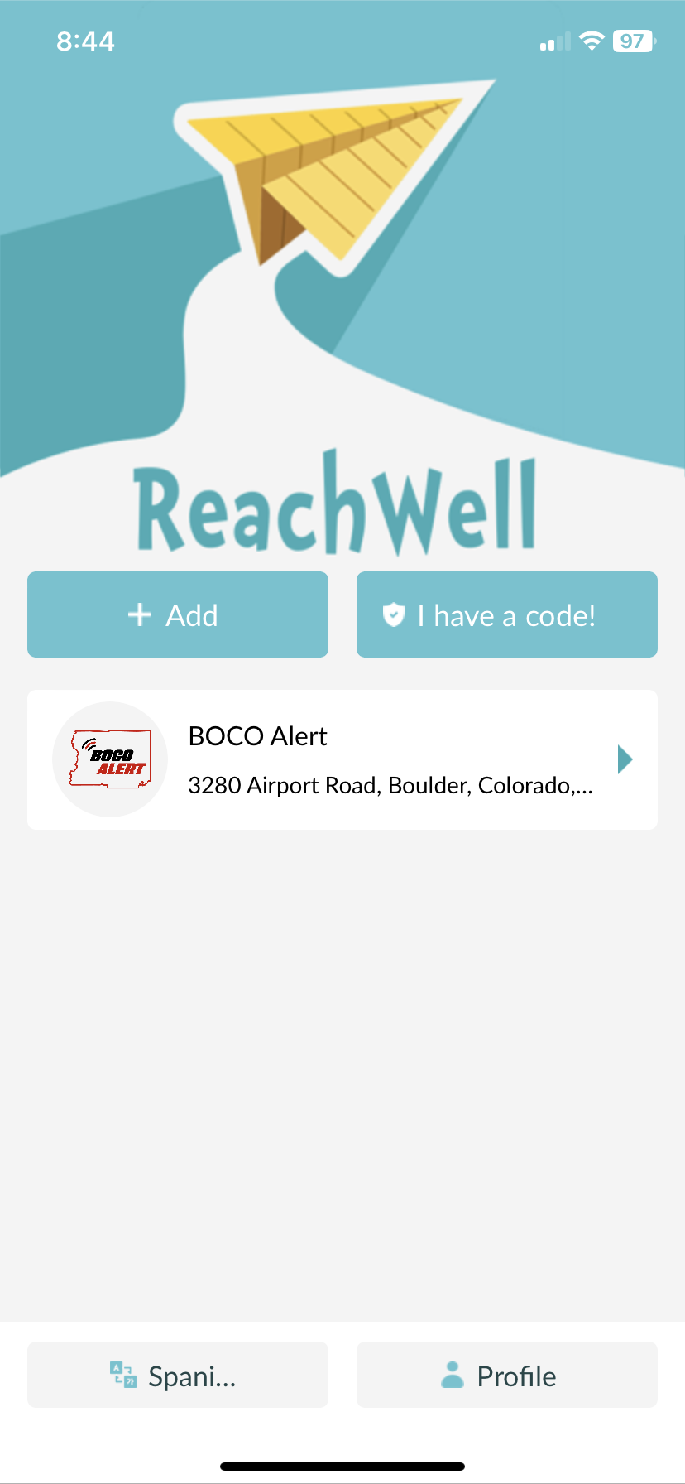
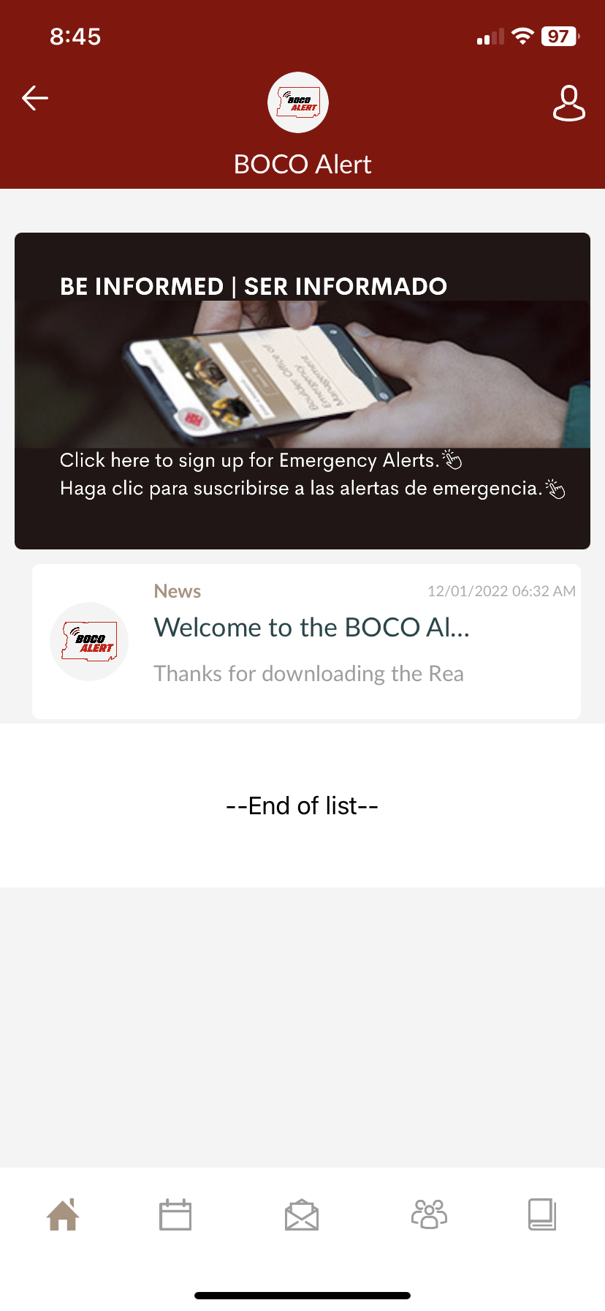
ReachWell Translation App
Phone app
Download, then search for BOCO Alert
Provides alerts in over 100 languages
And the most impotant thing: the audience won’t miss the point of your presentation

Slide 11
Remember… You are always your first notification.
Notes:
This could be based on your personal experience, or your understanding of what disasters we are vulnerable to.

Slide 12
Initiating an Alert
Incident Command
Dispatch
Public
And the most impotant thing: the audience won’t miss the point of your presentation

Slide 13
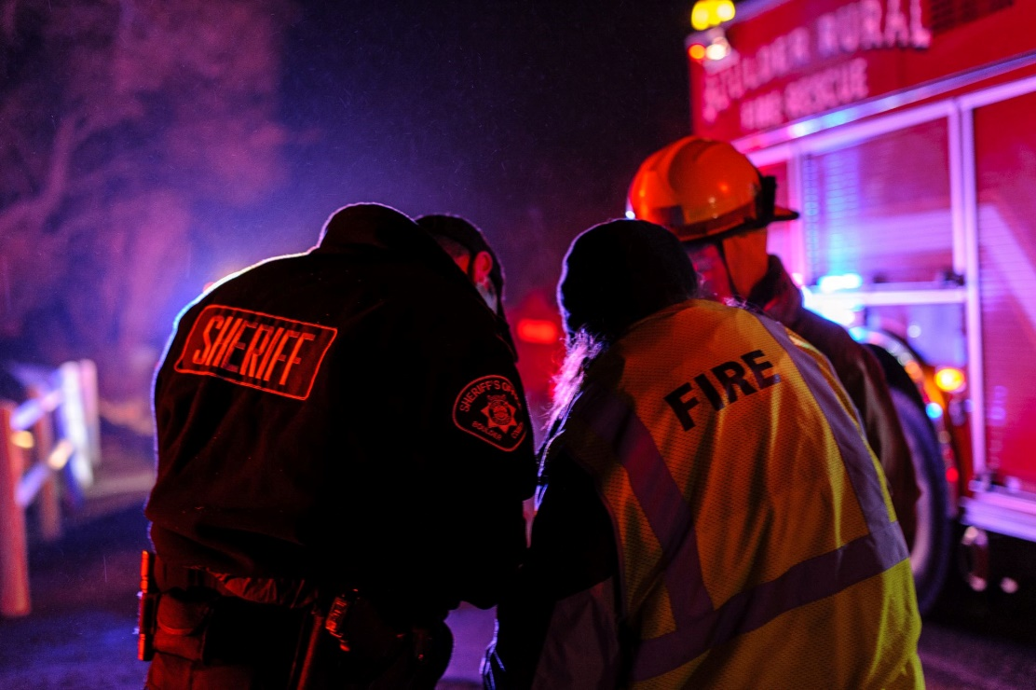
Incident Command

Slide 14
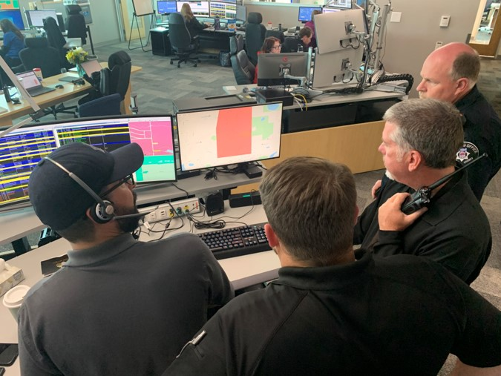
Dispatch

Slide 15
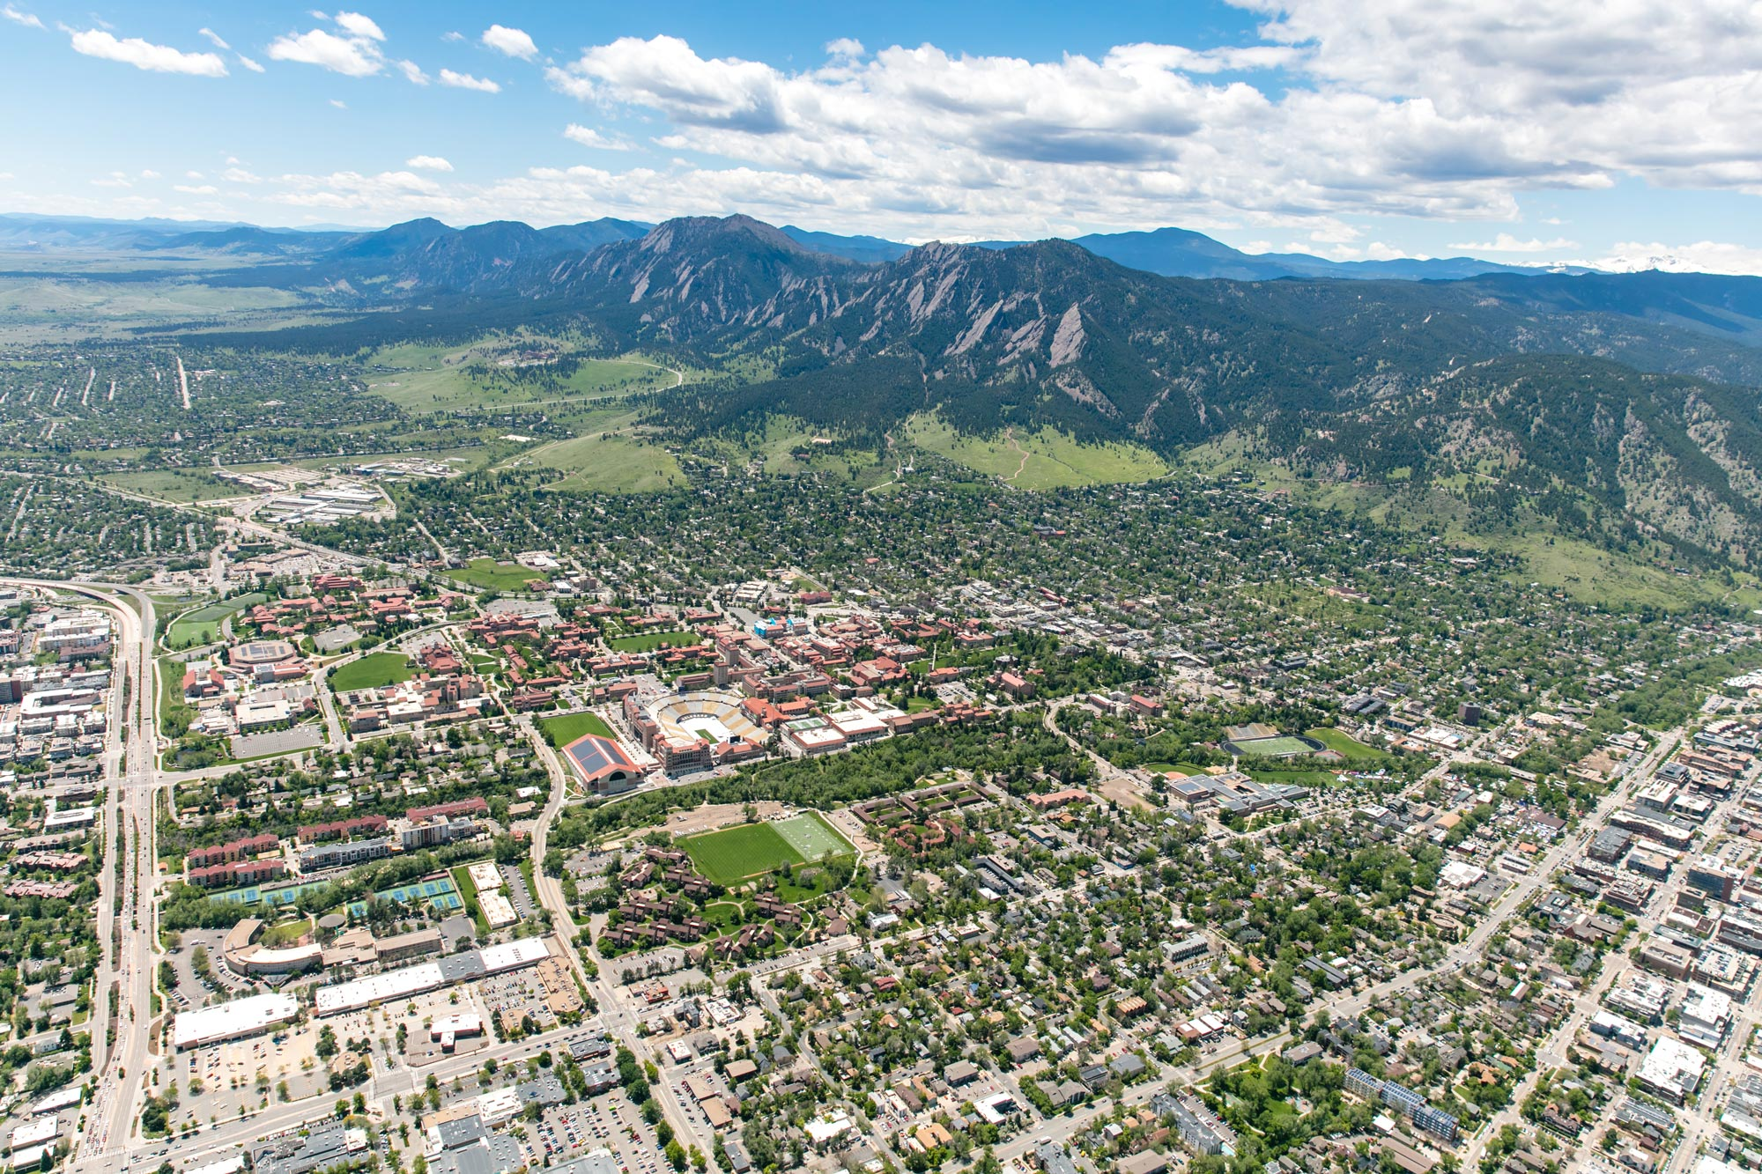
Public

Slide 16
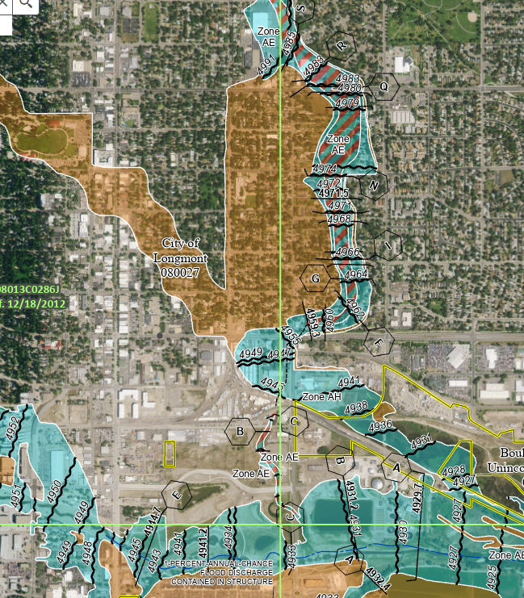
Notification Terminology
Types of notifications
Advisory
Warning
Order

Slide 17
ADVISORY
Used to raise awareness

Slide 18
WARNING
Used to get you ready to take action

Slide 19
ORDER
Used to share directives that should be followed immediately

Slide 20
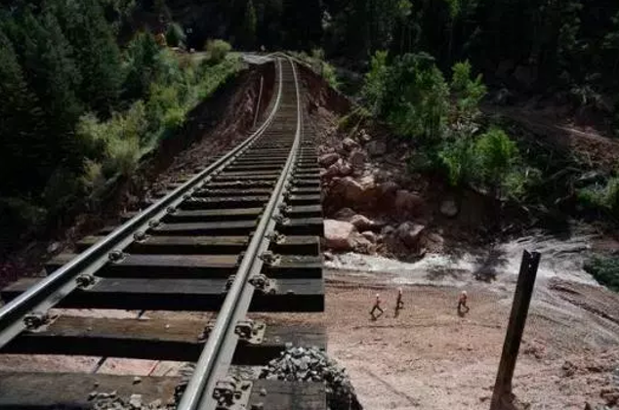
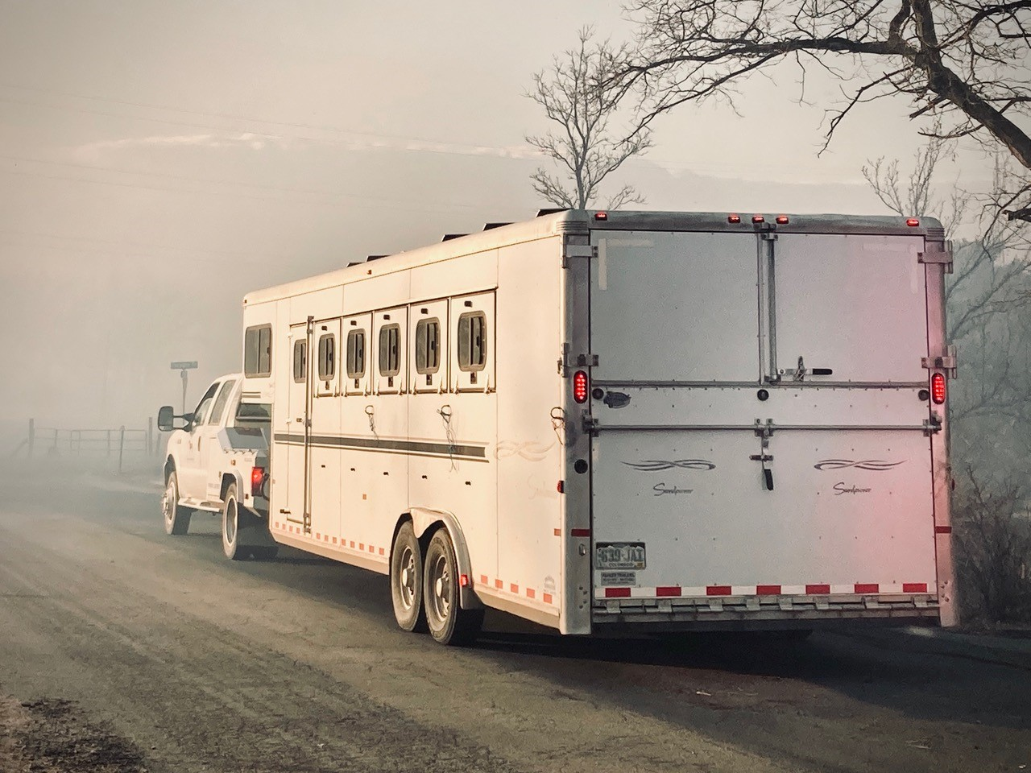
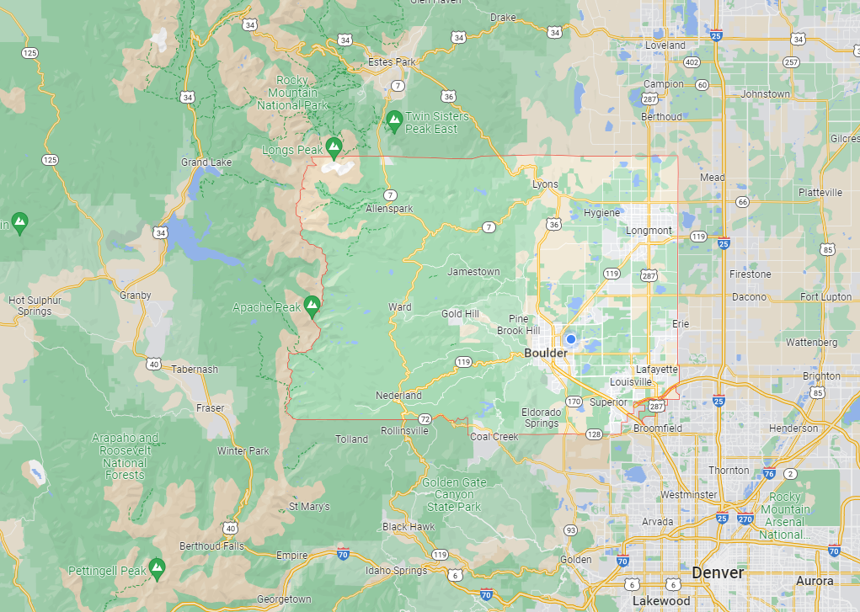
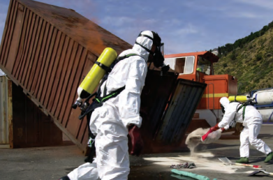
Notification Actions
Climb to higher ground – A directive to move to a location nearby that is higher than your current position.
Evacuation – A directive to leave the area immediately.
Shelter-in-place – A directive to remain indoors until the situation is resolved.
And the most impotant thing: the audience won’t miss the point of your presentation

Slide 21
Notification Actions
Missing/endangered person(s) – Information about a missing or endangered person that is shared to increase community awareness.
All clear – Follow-up information issued after officials have determined the hazard no longer presents a threat to the community.
And the most impotant thing: the audience won’t miss the point of your presentation

Slide 22
Assessing Your Risk

Slide 23
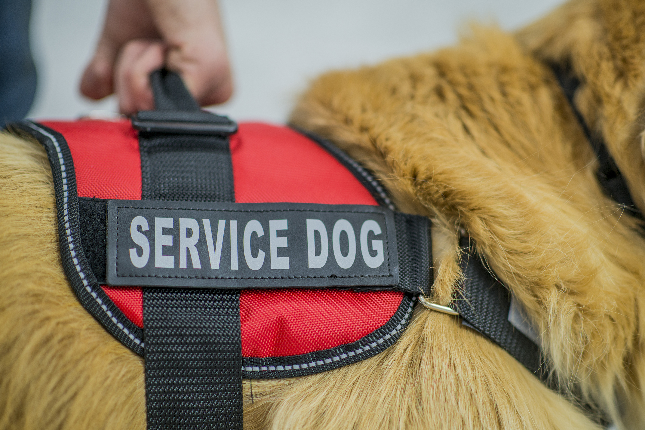
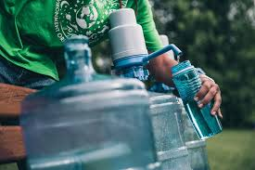
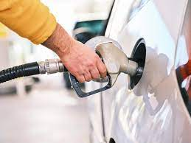
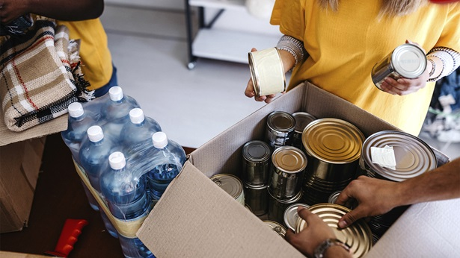
Lifelines
Security and safety
Food, water, and shelter
Health and medical
Power and gas
Communications
Transportation
And the most impotant thing: the audience won’t miss the point of your presentation

Slide 24
What things are you already doing to be prepared? What lifelines are you less certain that you have a plan for? What are some of your vulnerabilities?

Slide 25
Making a Plan

Slide 26
Planning Components
Actionable
Sustainable
And the most impotant thing: the audience won’t miss the point of your presentation

Slide 27
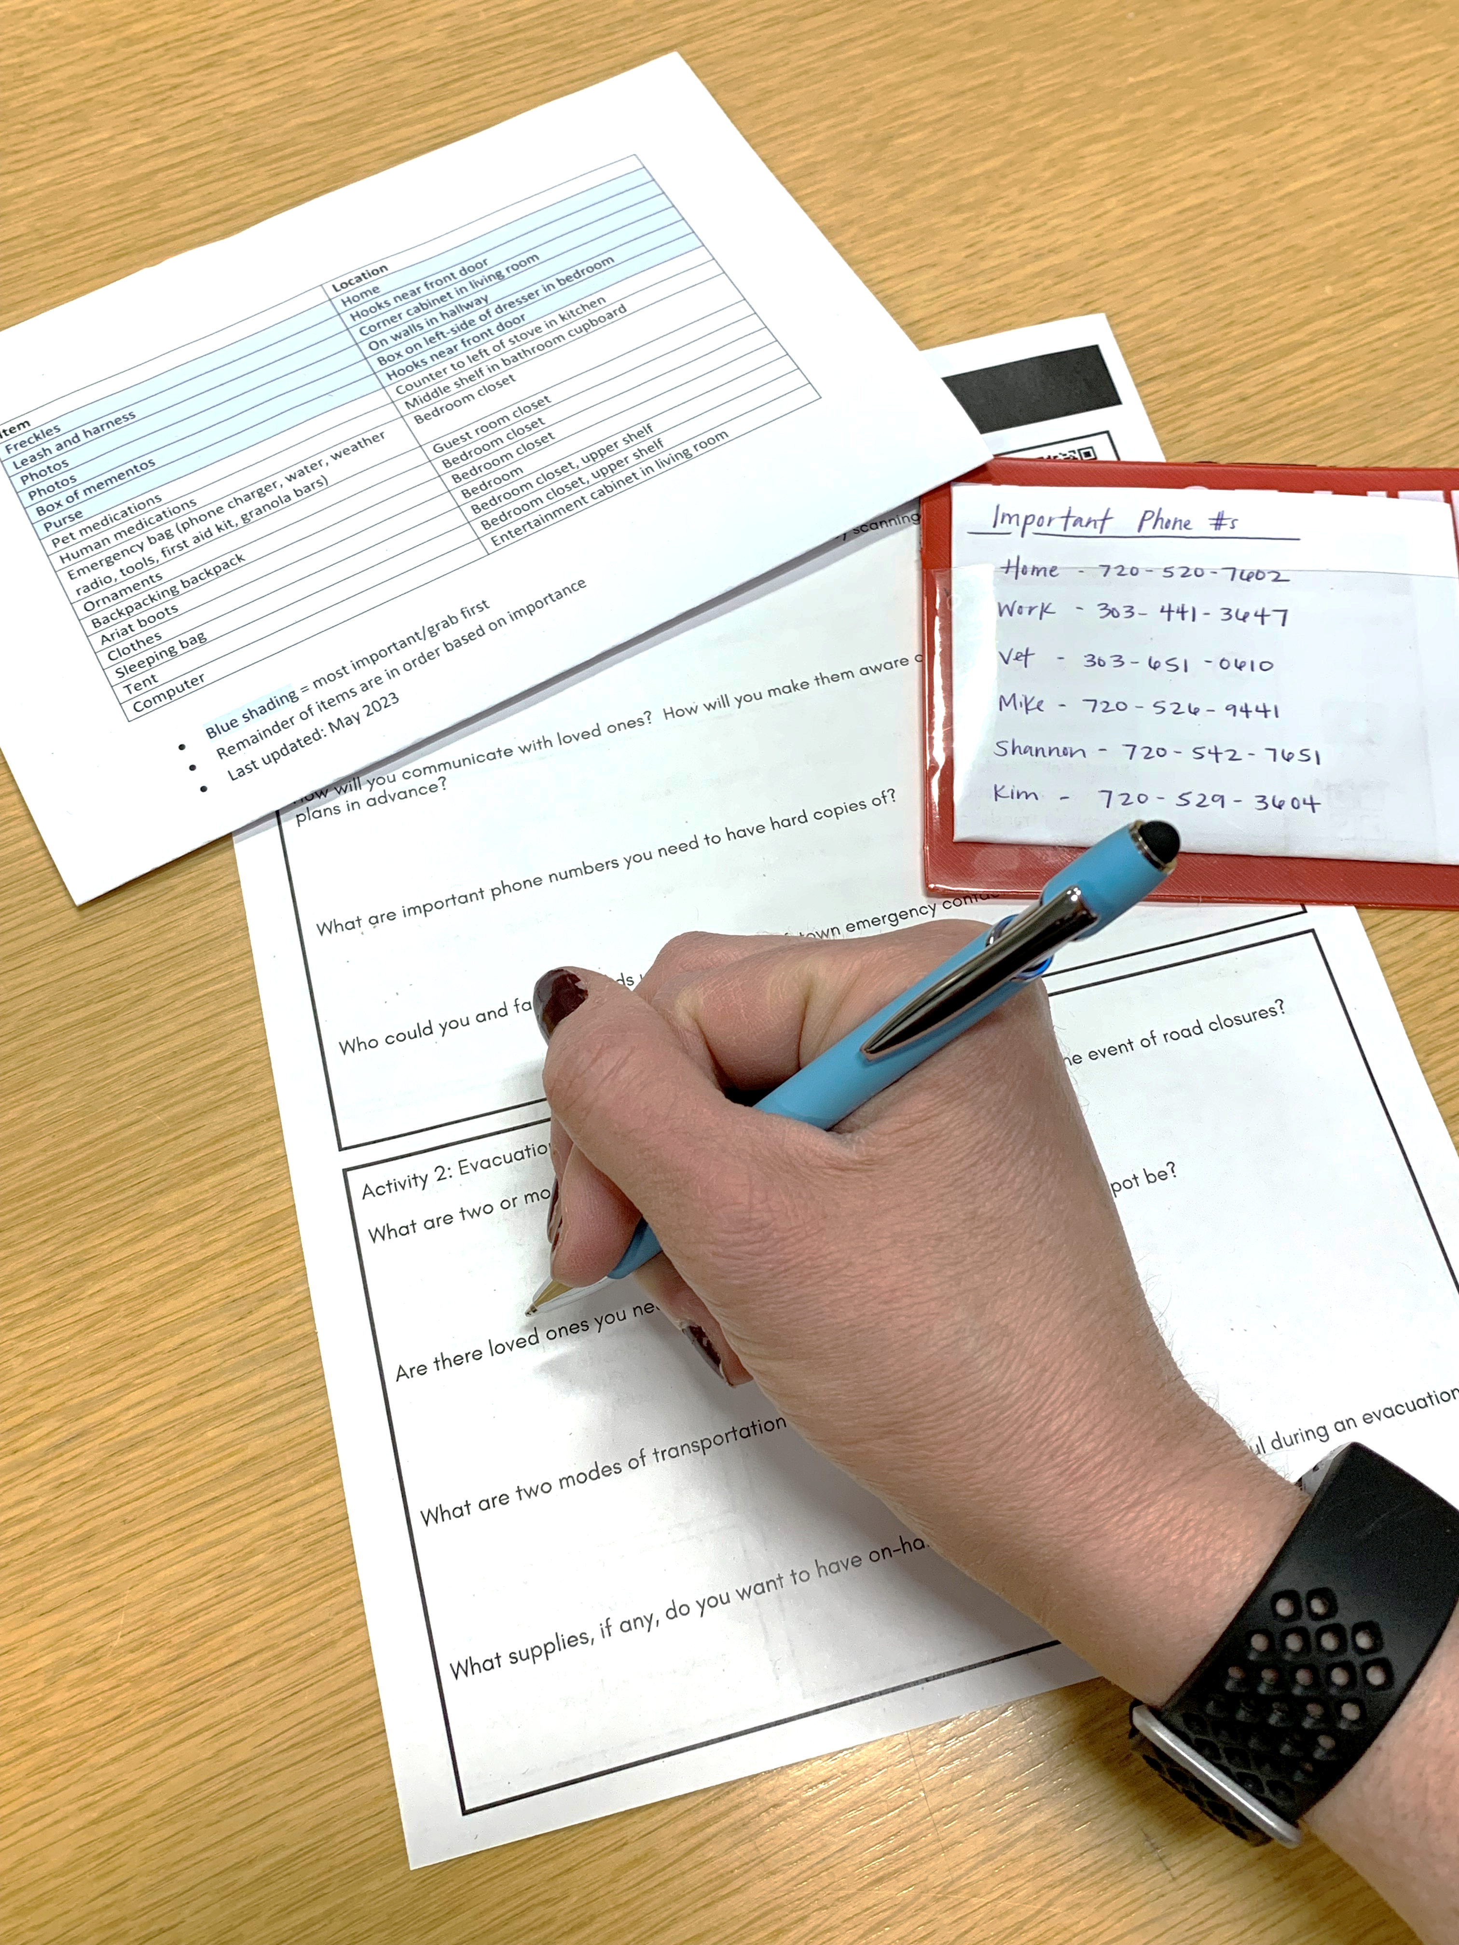
Creating Your Personal Plan
Communication
Evacuation or sheltering-in-place
Grab list
And the most impotant thing: the audience won’t miss the point of your presentation

Slide 28
Communication
Get informed
Stay informed
Key contacts
Text vs. call
And the most impotant thing: the audience won’t miss the point of your presentation

Slide 29
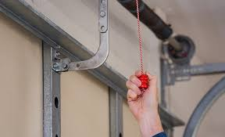
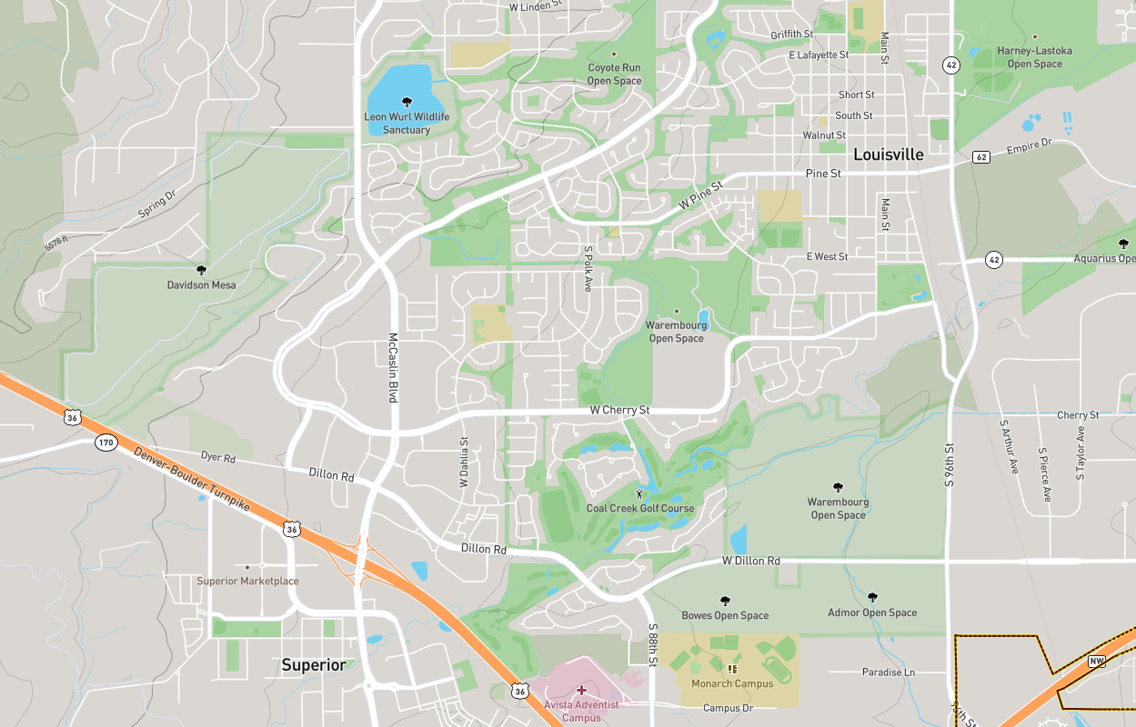
Evacuation or Sheltering-in-Place
Transportation
Garages
Routes
Maintaining lifelines
And the most impotant thing: the audience won’t miss the point of your presentation

Slide 30
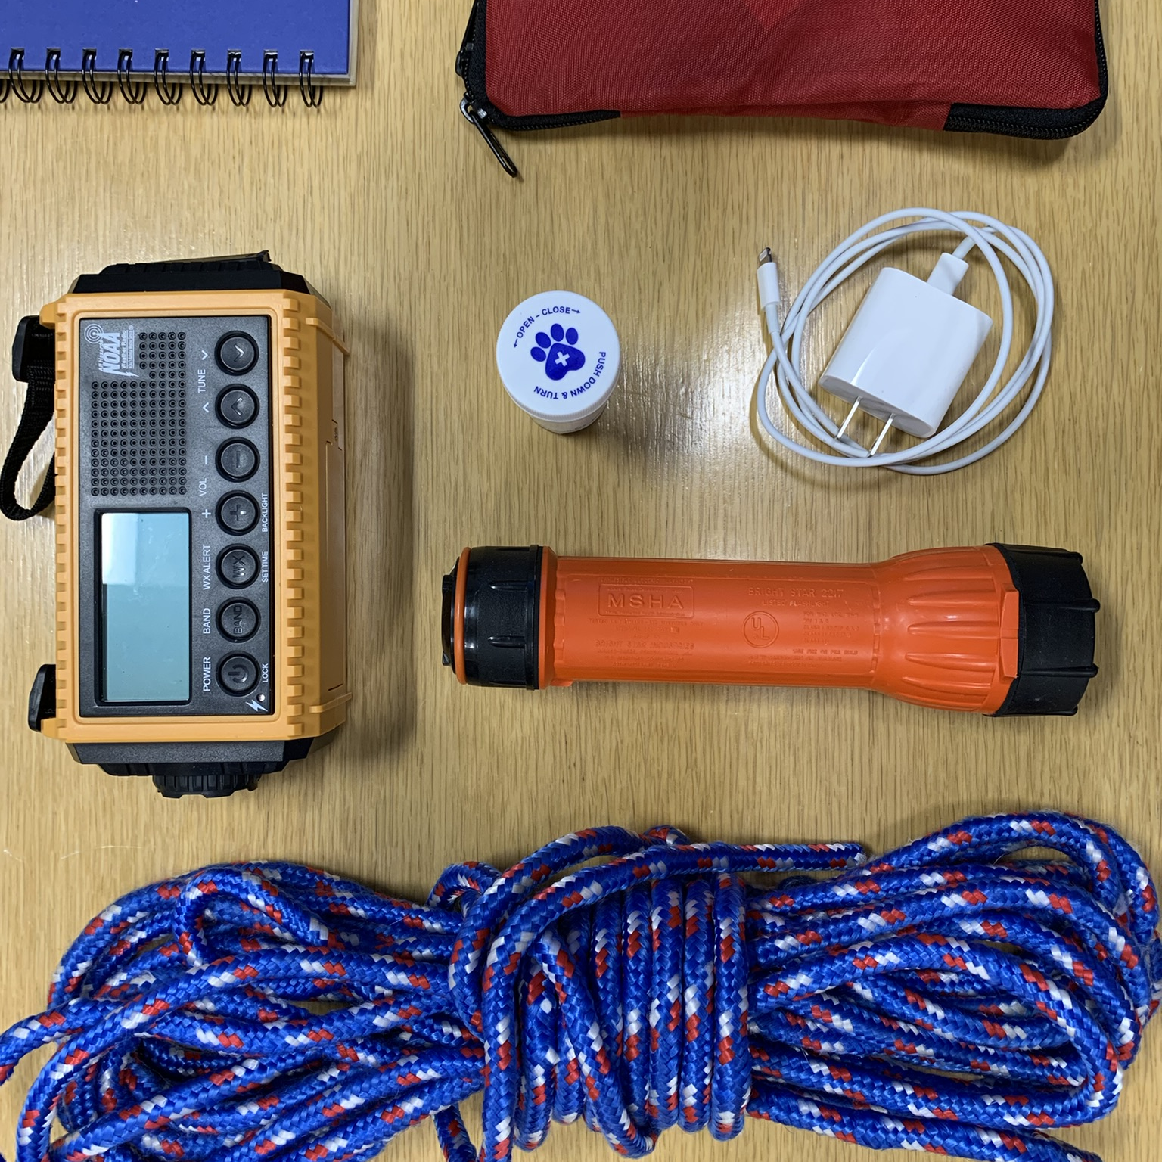
Grab List
The 7 Ps
People
Pets
Papers
Prescriptions
Pictures
Personal computers
Plastic

Slide 31
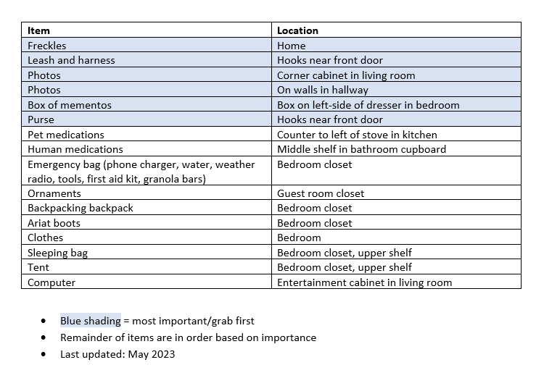
Example Grab List

Slide 32
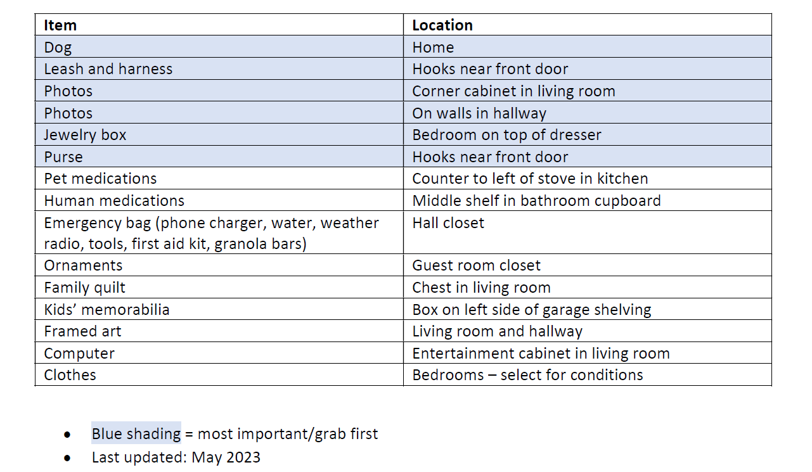
Example Grab List

Slide 33
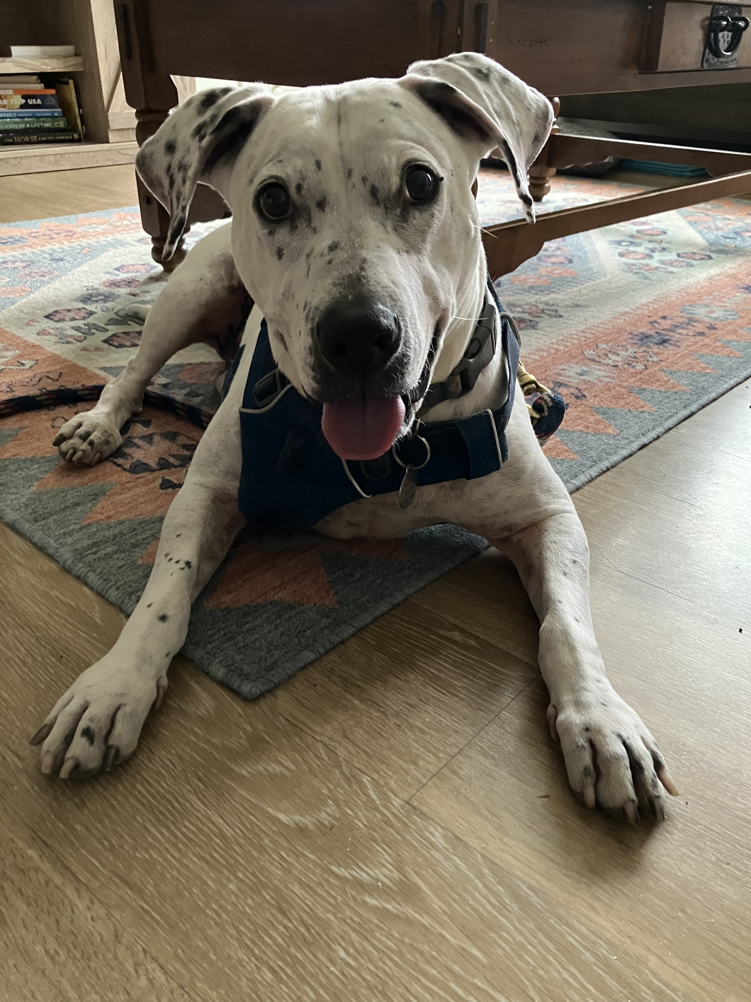
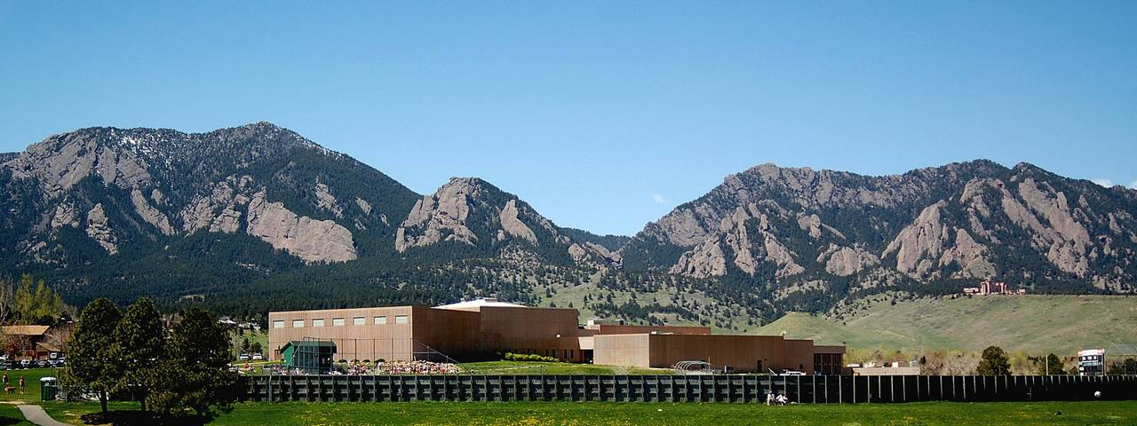
Additional Considerations
Access and functional needs
Time and place
Pets

Slide 34
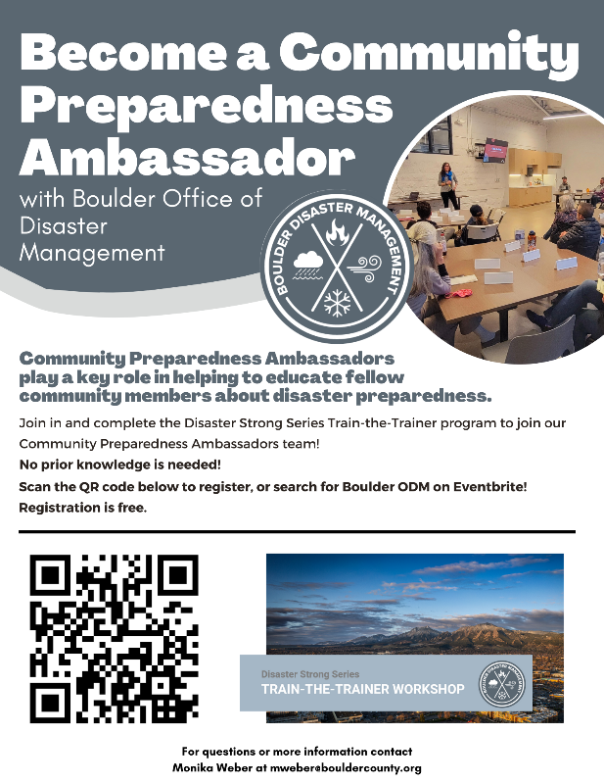
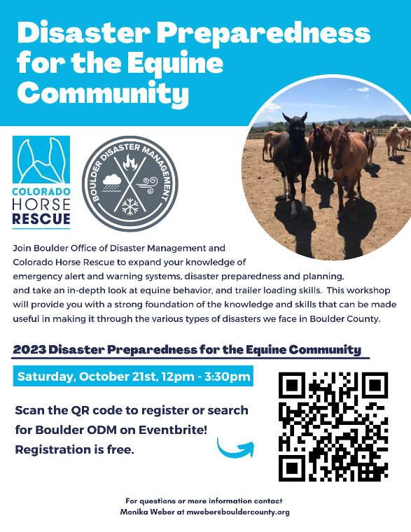
Additional Planning and Community Resources
Boulder ODM www.boulderodm.gov/preparedness/
Wildfire Partners
Local fire departments
Fire Adapted Colorado https://fireadaptedco.org/
Disaster Strong Series events
Train-the-Trainer
Preparedness for Access and Functional Needs
Preparedness for the Equine Community

Slide 35
Thank you!
Monika Weber mweber@bouldercounty.org

Slide 36
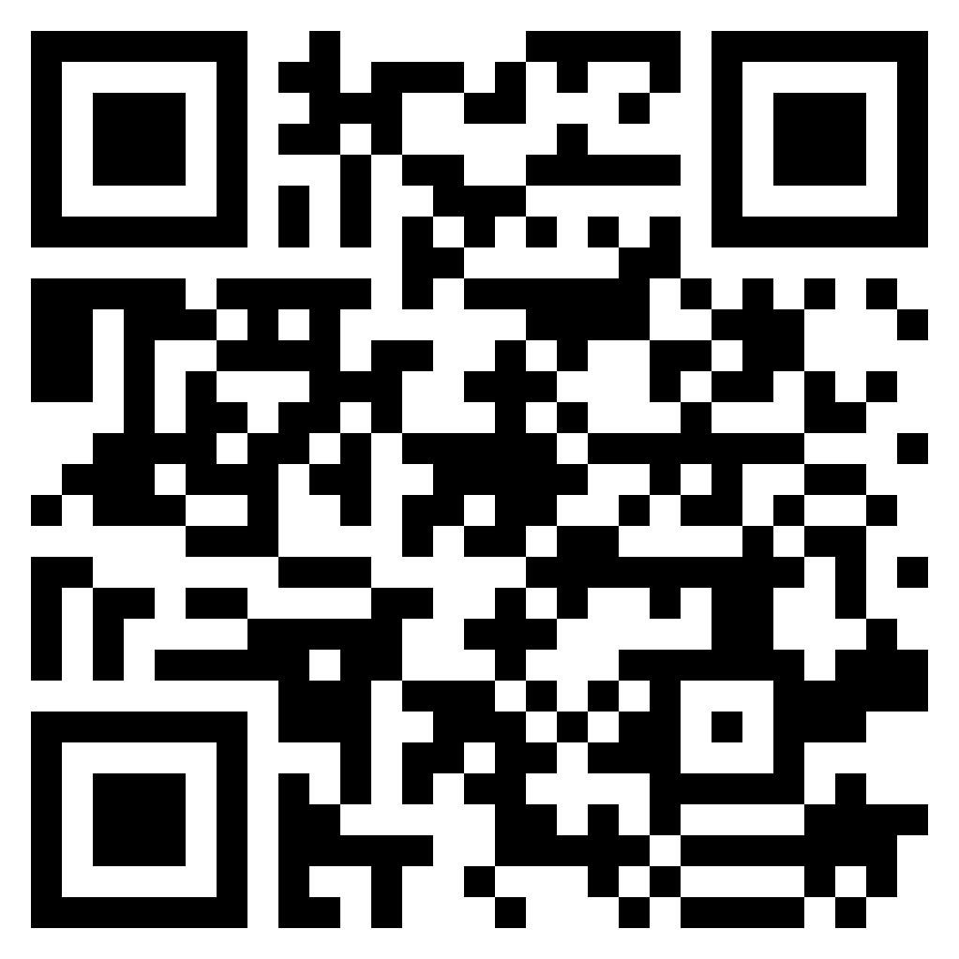
Workshop Feedback
Notes:
This could be based on your personal experience, or your understanding of what disasters we are vulnerable to.

