Slide 1
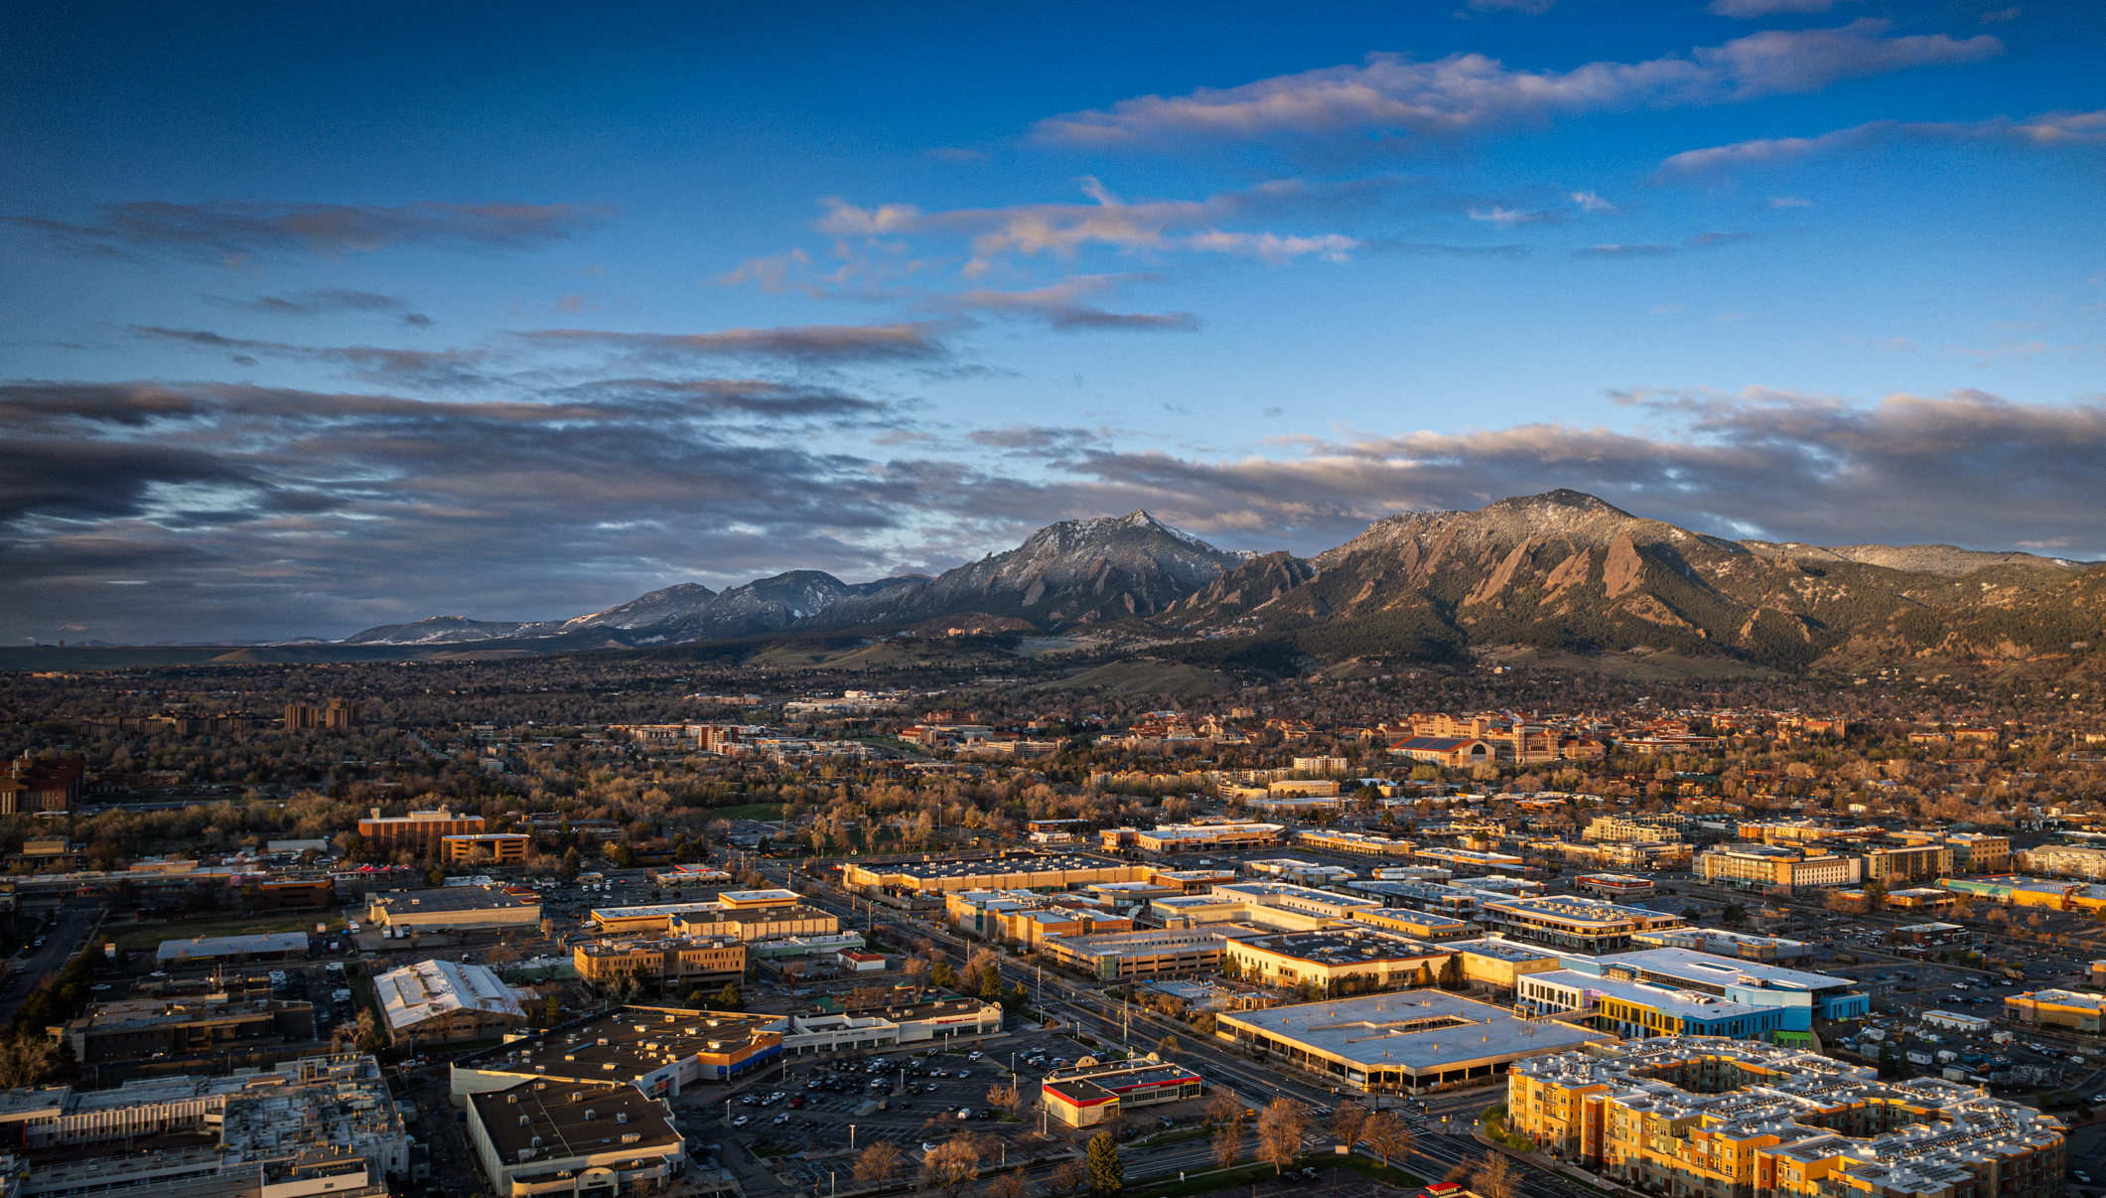
PREPAREDNESS BASICS
Disaster Strong Series

Slide 2
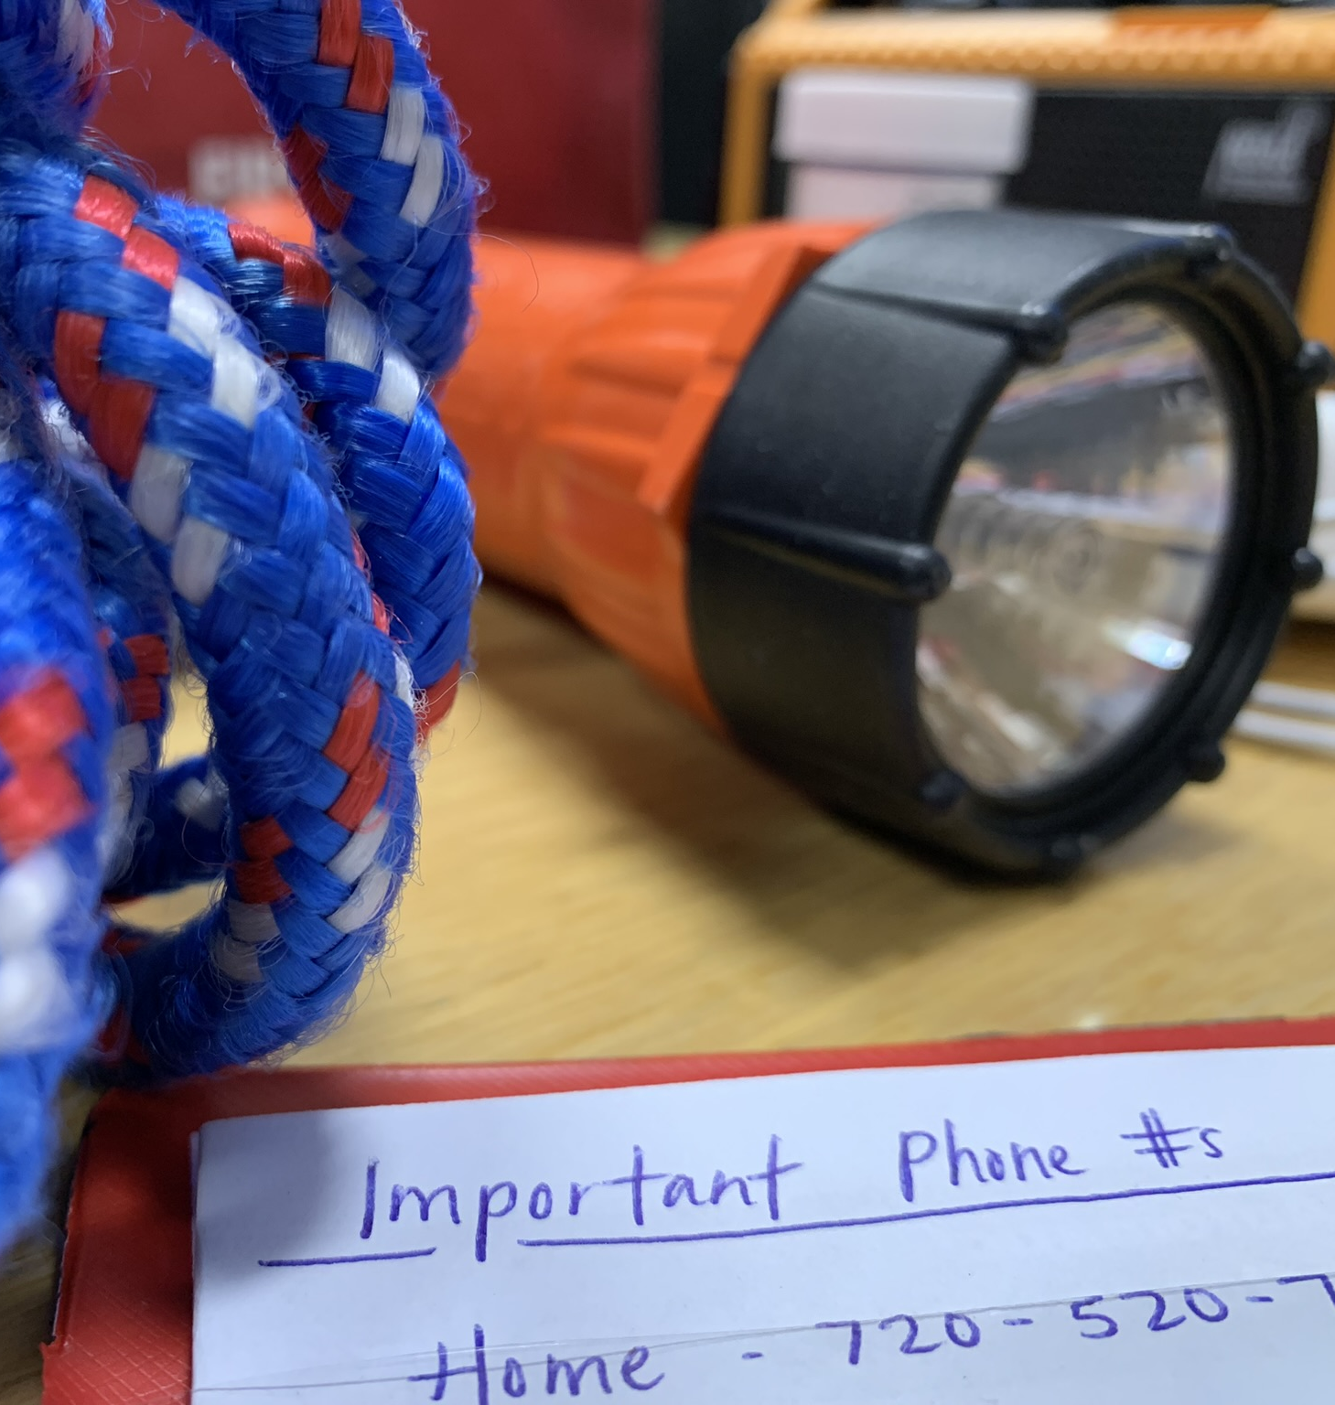
Overview
Boulder County Hazard Profile
Alert and Warning
Assessing Your Risk
Making a Plan
And the most impotant thing: the audience won’t miss the point of your presentation

Slide 3
Boulder County Hazard Profile

Slide 4
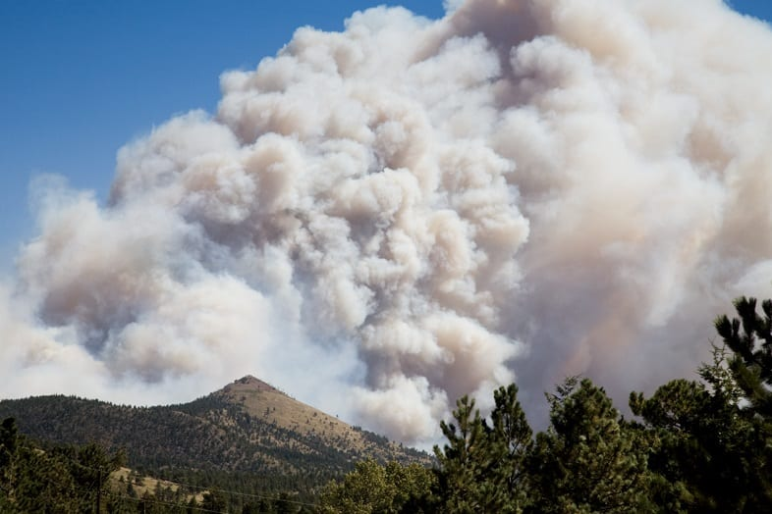
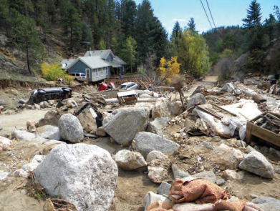
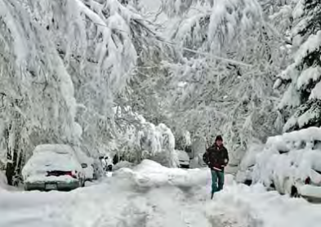
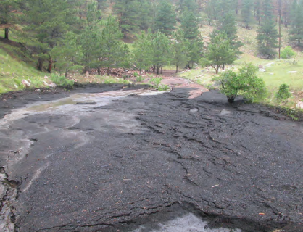
Disasters in Boulder County
Introduction of terminology
Disaster
Emergency
Disaster history
And the most impotant thing: the audience won’t miss the point of your presentation

Slide 5
What types of disasters have you experienced, or do you think we could experience in our county?

Slide 6
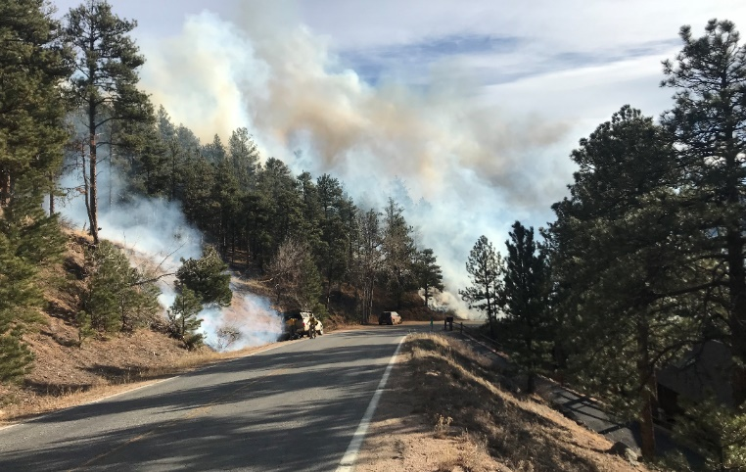
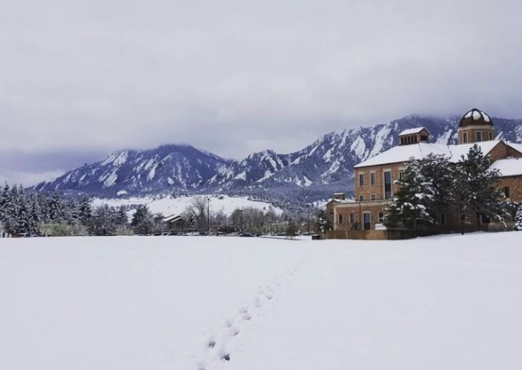
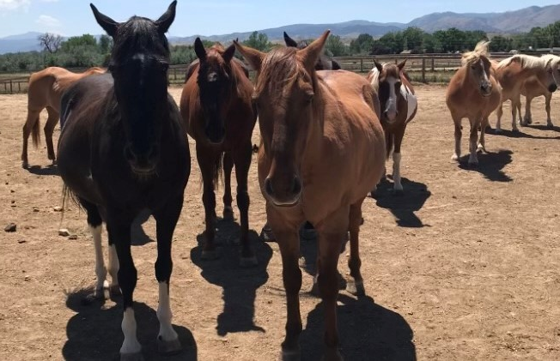
Top 5 Risks (2023)
Wildfire
Communicable Disease/Zoonotic Outbreak
Flood
Winter Storm
Extreme Temperatures
And the most impotant thing: the audience won’t miss the point of your presentation

Slide 7
Emergency Alerts

Slide 8
How do you typically get information emergencies or disasters?

Slide 9
Types of Notification
You
Neighbors/friends
Everbridge Opt-In Alerts
ReachWell Translation App
Wireless Emergency Alert (WEA)
Emergency Alert System (EAS)
NOAA All-Hazards Weather Radio
Sirens
Door to door
Social media

Slide 10
Everbridge Opt-In Alerts
Types
Call
Text
E-mail
Manage your account
Add up to 5 addresses
You will only get notifications for impacted areas near one of the addresses affiliated with your account.
And the most impotant thing: the audience won’t miss the point of your presentation

Slide 11
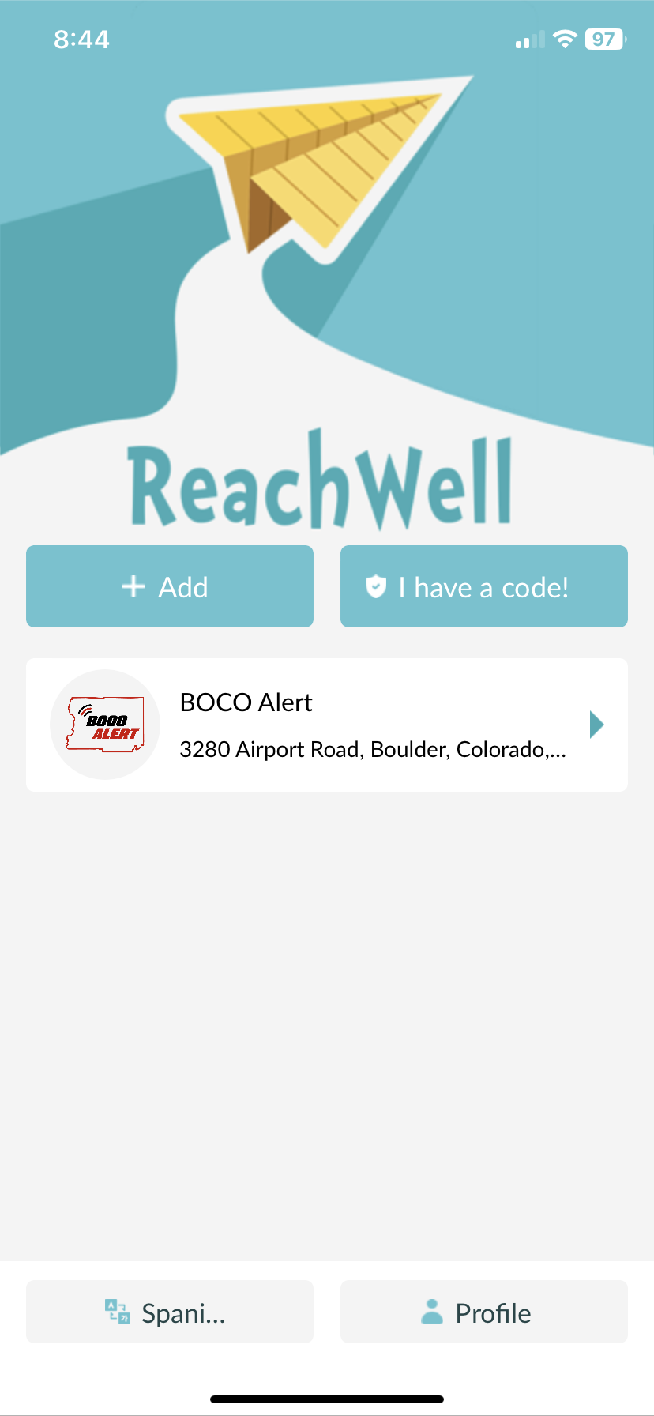
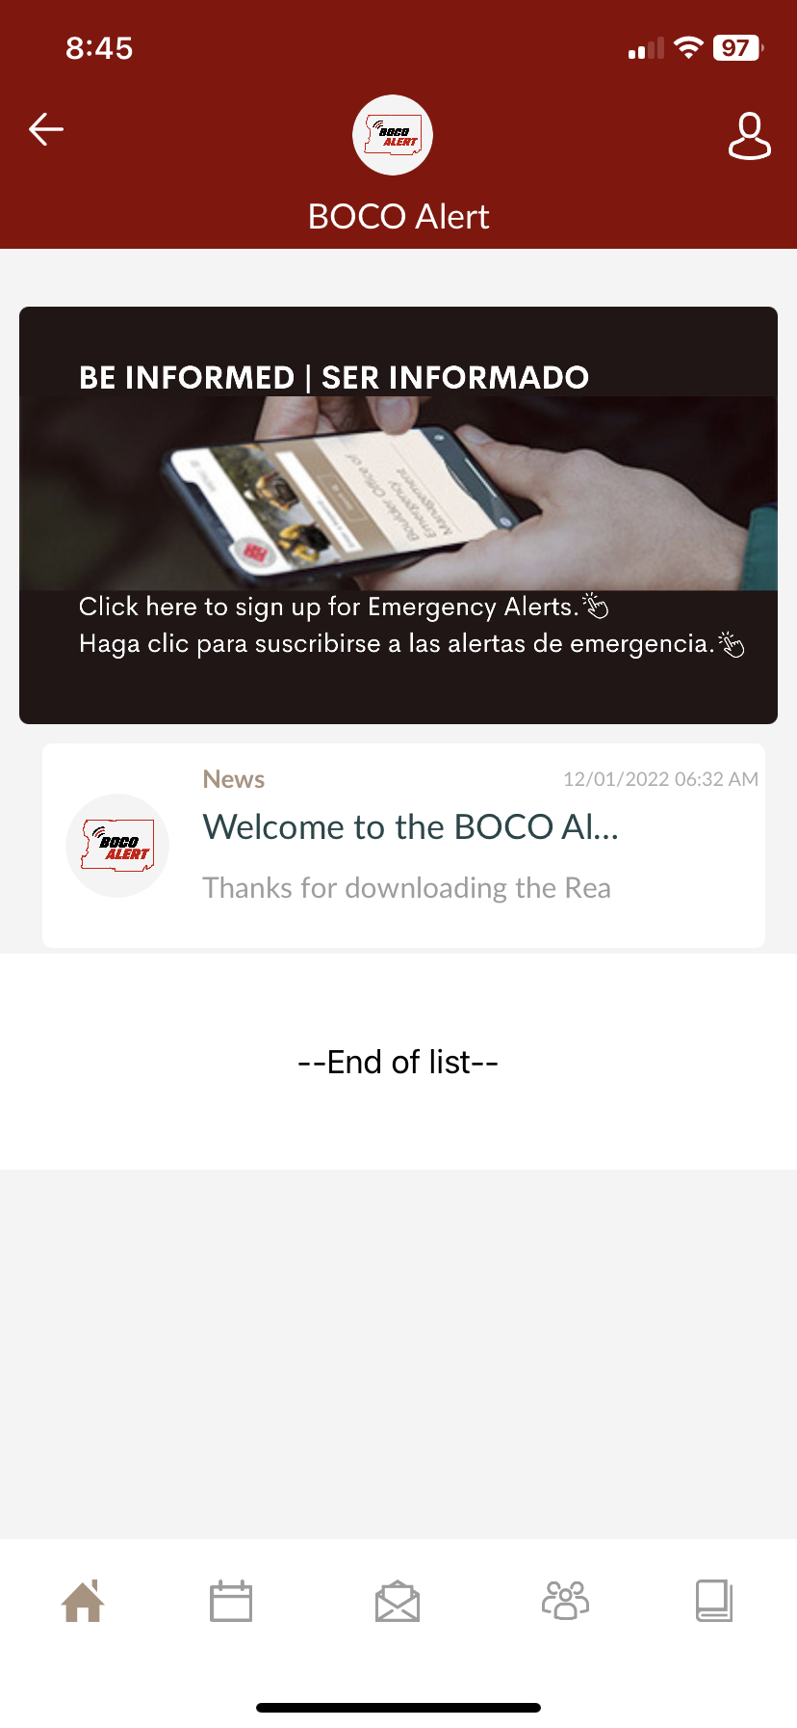
ReachWell Translation App
Phone app
Download, then search for BOCO Alert
Provides alerts in over 100 languages
And the most impotant thing: the audience won’t miss the point of your presentation

Slide 12
Remember… You are always your first notification.
Notes:
This could be based on your personal experience, or your understanding of what disasters we are vulnerable to.

Slide 13
Initiating an Alert
And the most impotant thing: the audience won’t miss the point of your presentation

Slide 14
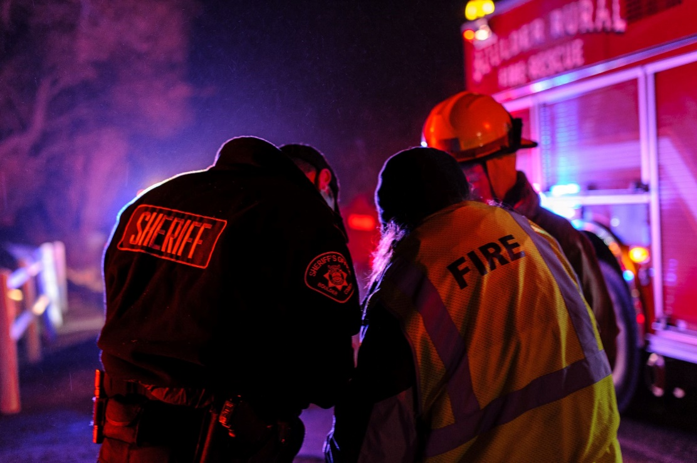
Incident Command

Slide 15
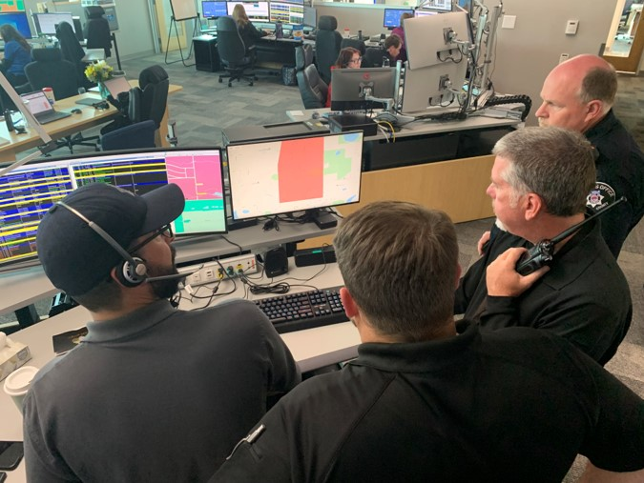
Dispatch

Slide 16
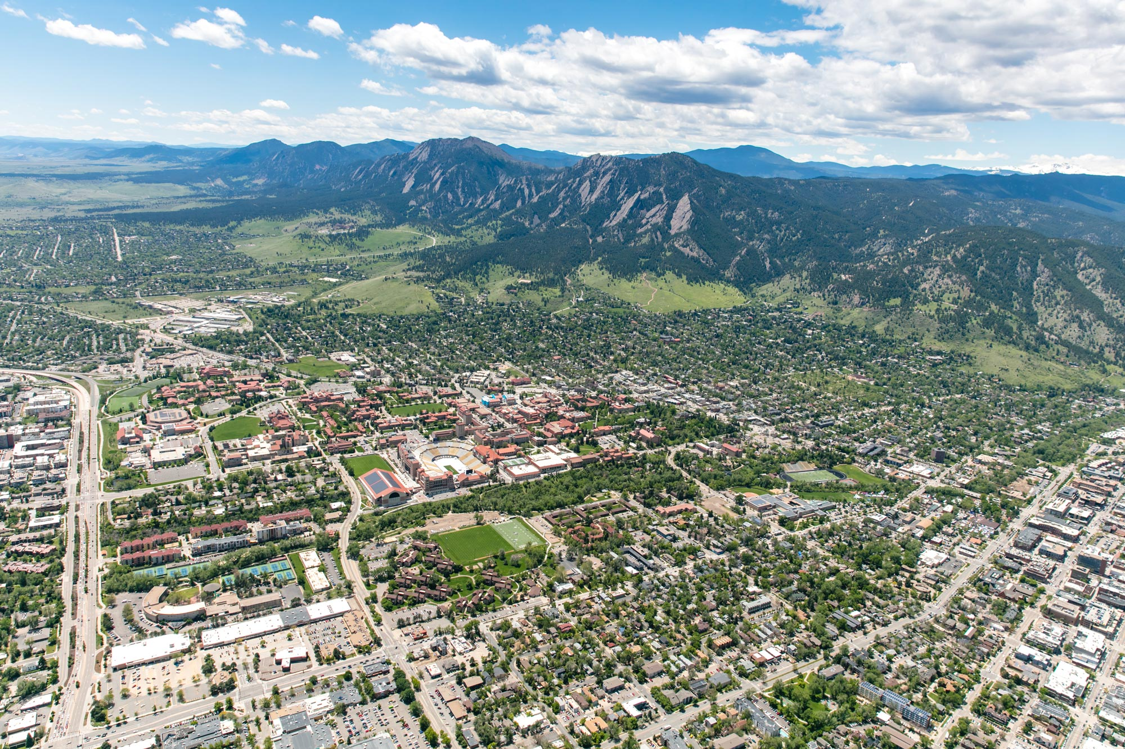
Public

Slide 17
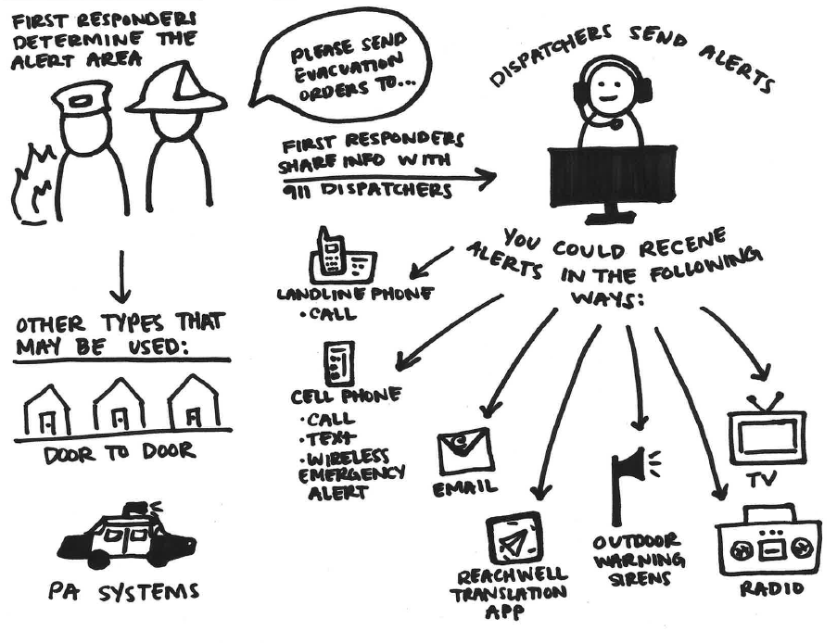
And the most impotant thing: the audience won’t miss the point of your presentation

Slide 18
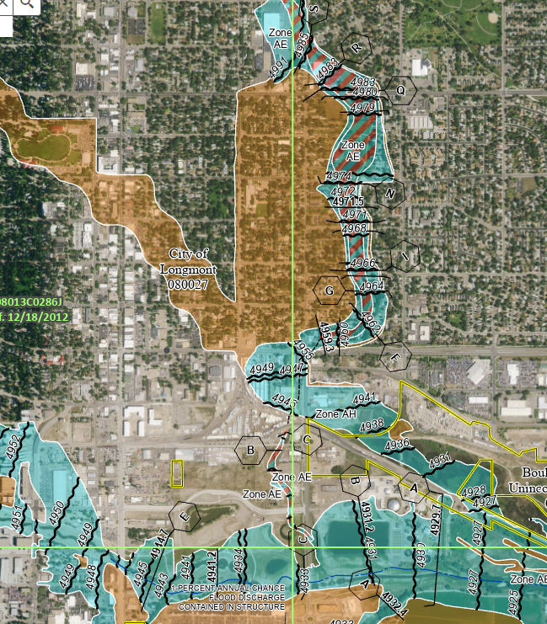
Notification Terminology
Types of notifications
Advisory
Warning
Order

Slide 19
ADVISORY
Used to raise awareness

Slide 20
WARNING
Used to get you ready to take action

Slide 21
ORDER
Used to share directives that should be followed immediately

Slide 22
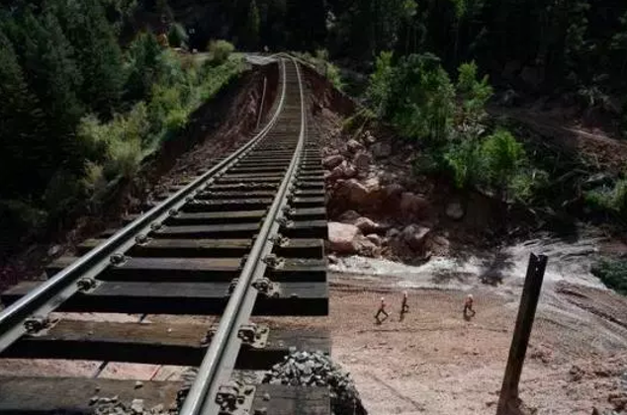
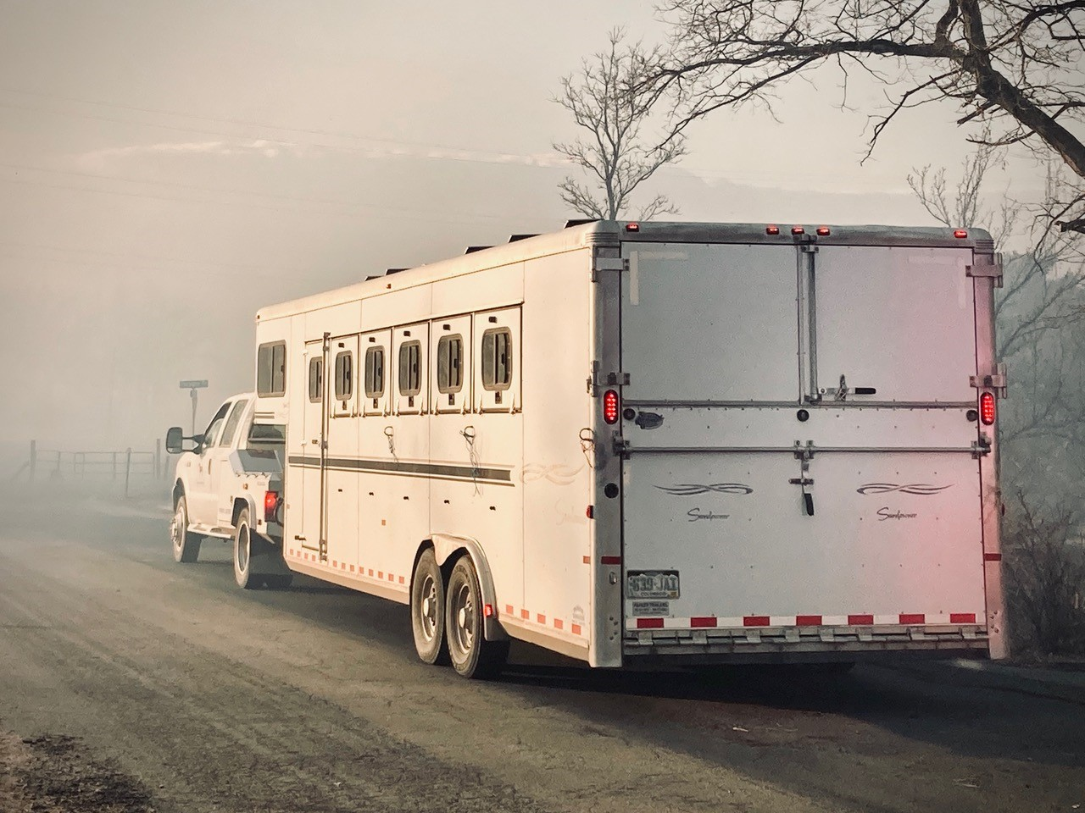
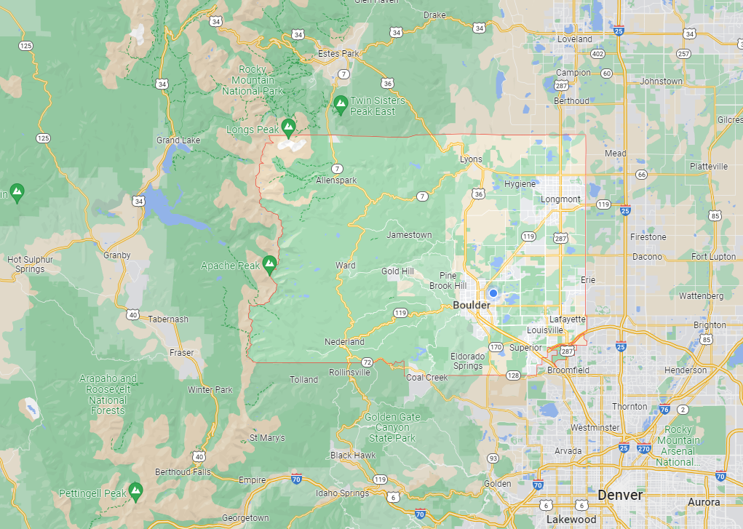
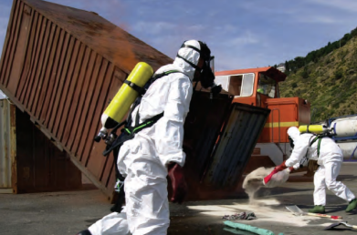
Notification Actions
Climb to higher ground – A directive to move to a location nearby that is higher than your current position.
Evacuation – A directive to leave the area immediately.
Shelter-in-place – A directive to remain indoors until the situation is resolved.
And the most impotant thing: the audience won’t miss the point of your presentation

Slide 23
Notification Actions
Missing/endangered person(s) – Information about a missing or endangered person that is shared to increase community awareness.
All clear – Follow-up information issued after officials have determined the hazard no longer presents a threat to the community.
And the most impotant thing: the audience won’t miss the point of your presentation

Slide 24
Assessing Your Risk

Slide 25
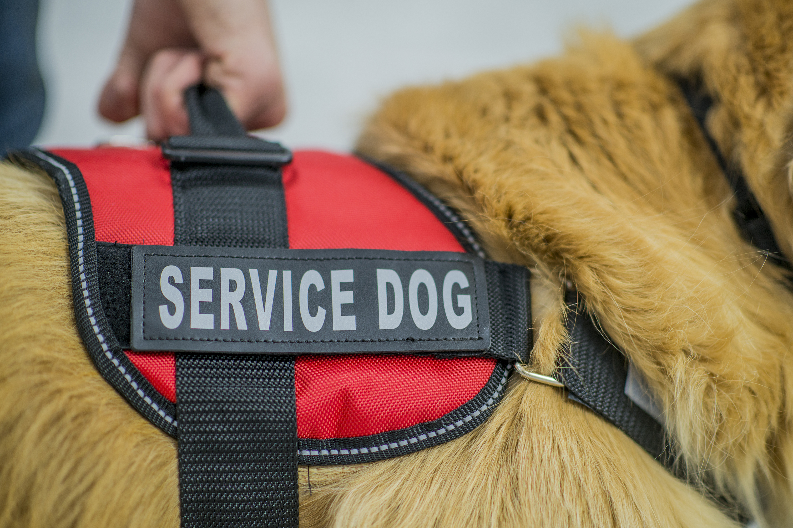
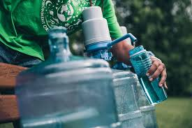
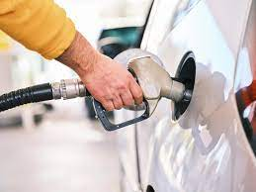
Lifelines
Food, water, and shelter
Health and medical
Power and gas
Communications
Transportation
And the most impotant thing: the audience won’t miss the point of your presentation

Slide 26
Shocks vs. Stressors

Slide 27
What things are you already doing to be prepared? What lifelines are you less certain that you have a plan for? What are some of your vulnerabilities?

Slide 28
Making a Plan

Slide 29
Planning Components
Actionable
Sustainable
And the most impotant thing: the audience won’t miss the point of your presentation

Slide 30
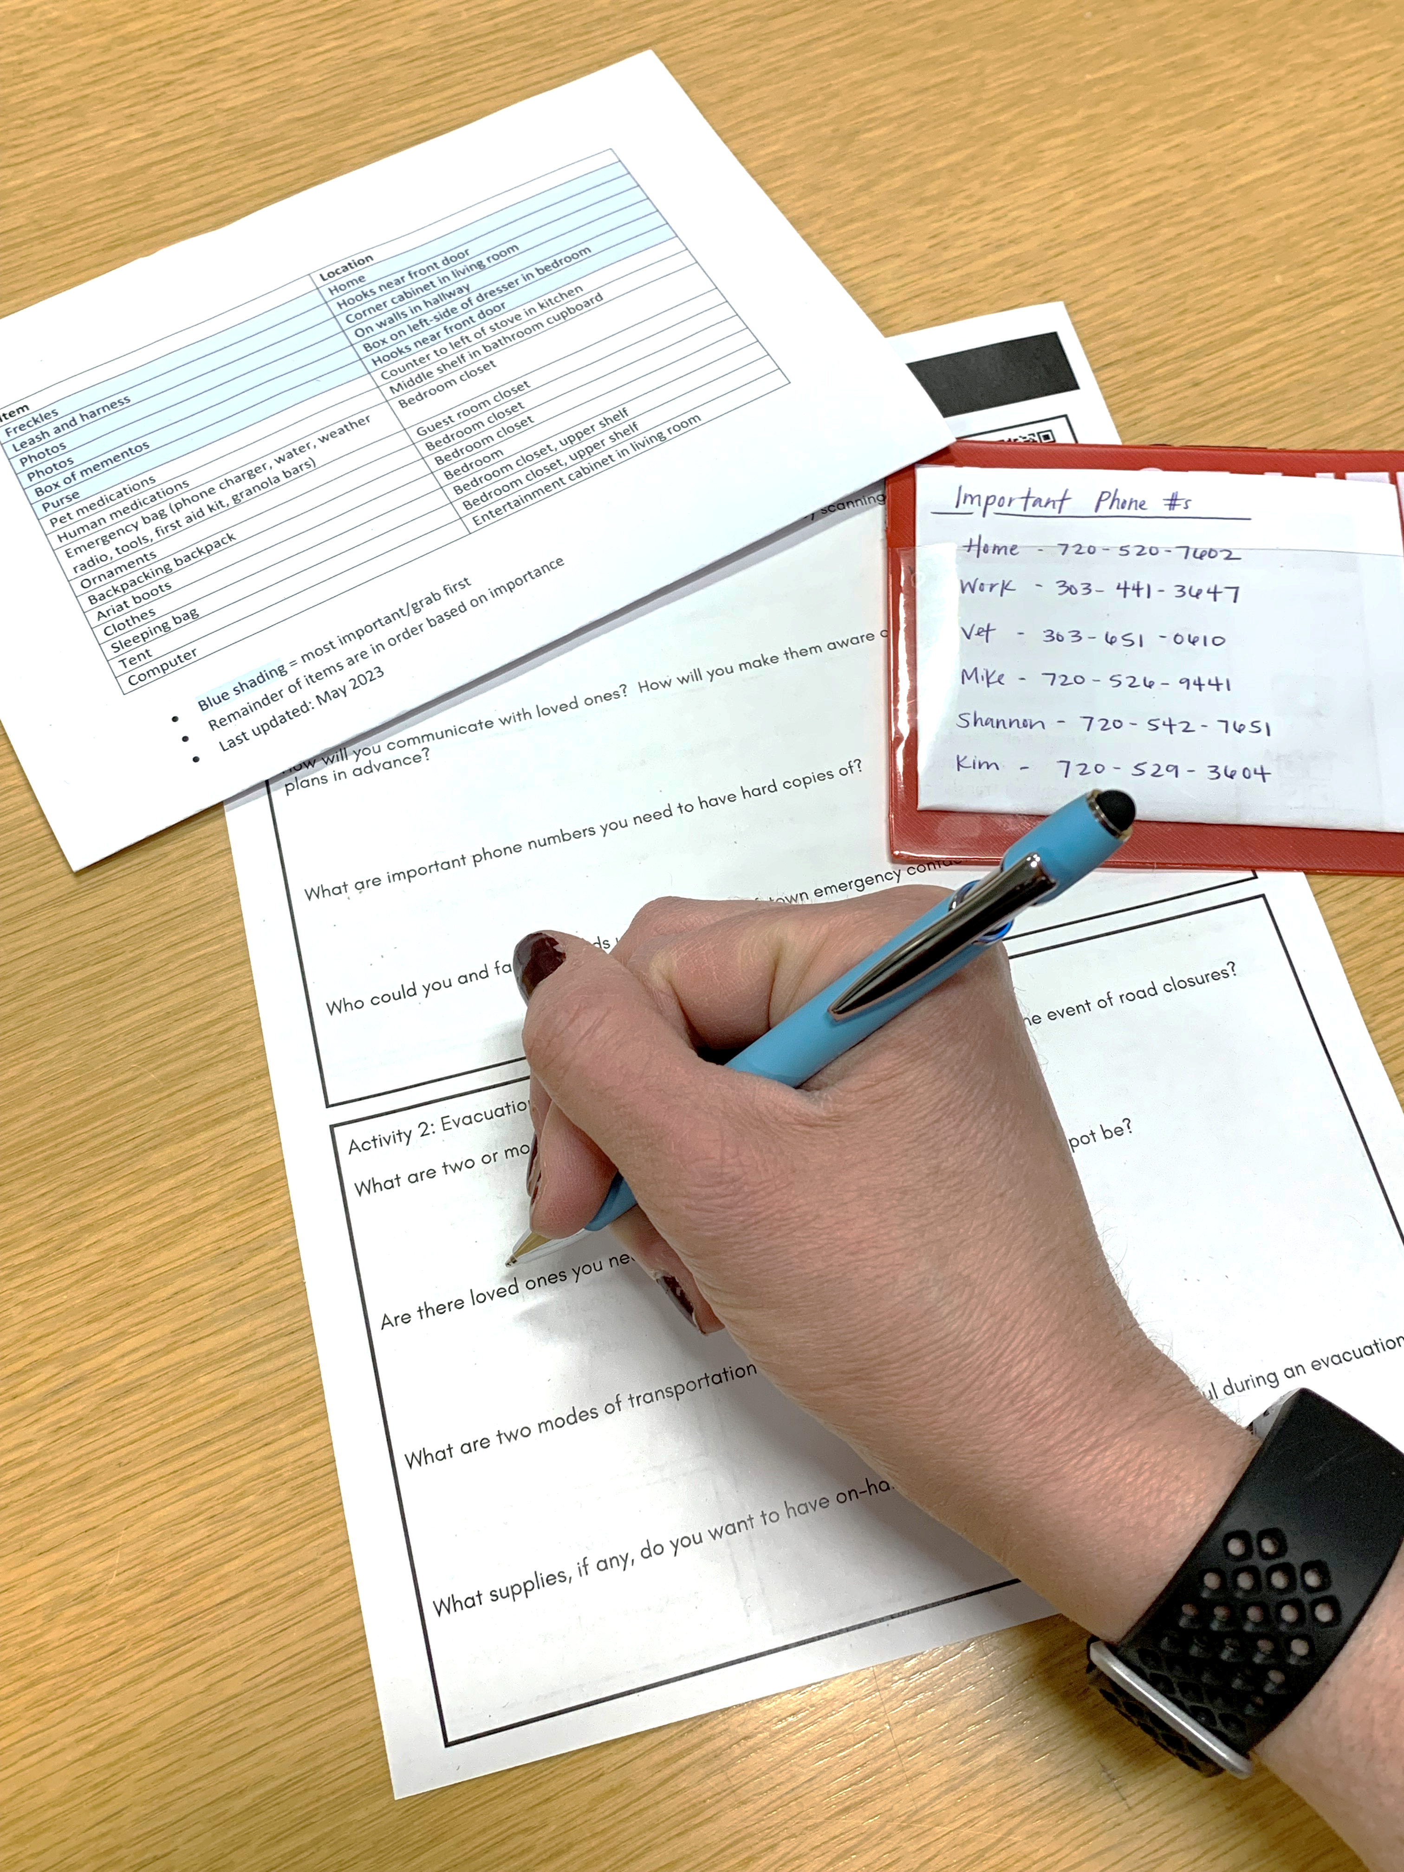
Creating Your Personal Plan
Communication
Evacuation or sheltering-in-place
Grab list
And the most impotant thing: the audience won’t miss the point of your presentation

Slide 31
Communication
Get informed
Stay informed
Key contacts
Text vs. call
And the most impotant thing: the audience won’t miss the point of your presentation

Slide 32
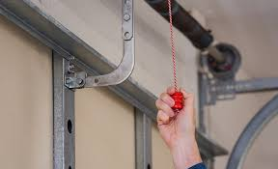
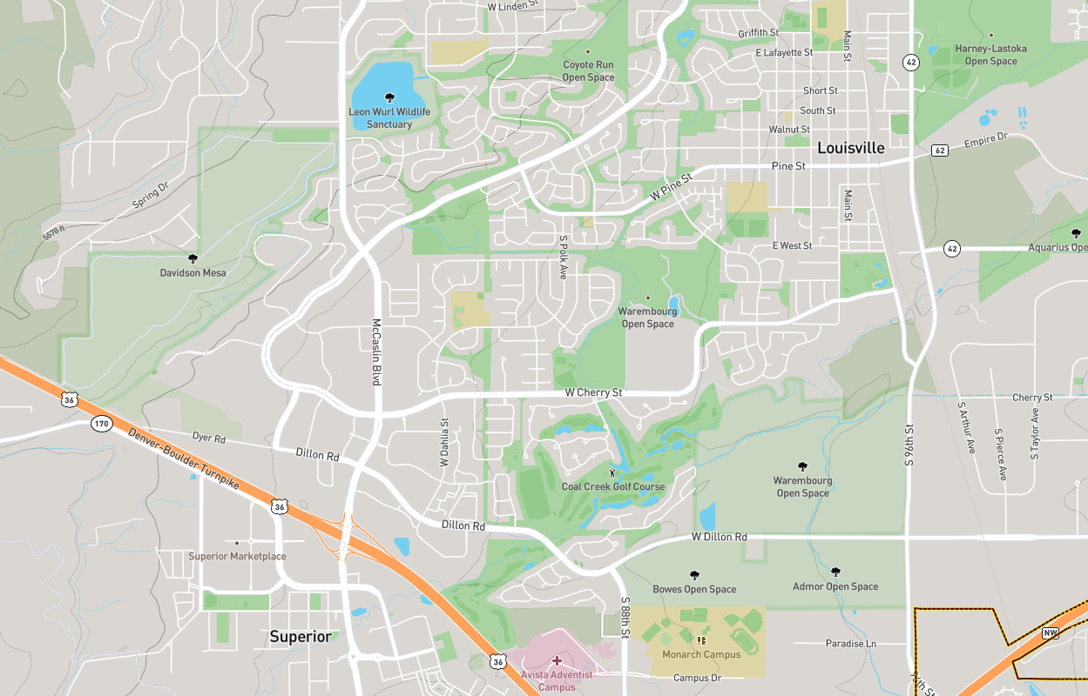
Evacuation or Sheltering-in-Place
Transportation
Garages
Routes
Maintaining lifelines
And the most impotant thing: the audience won’t miss the point of your presentation

Slide 33
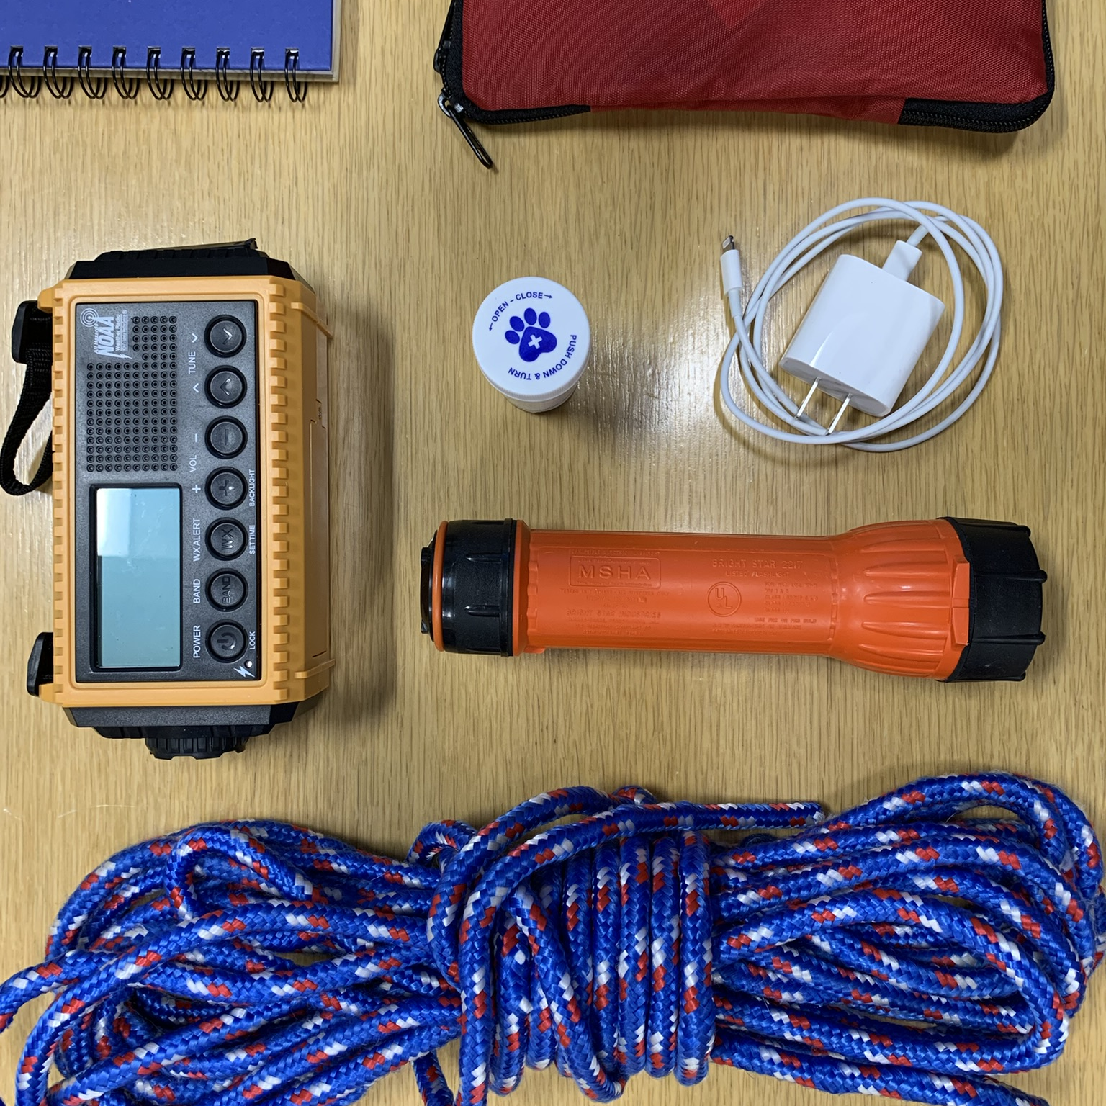
Grab List
The 7 Ps
People
Pets
Papers
Prescriptions
Pictures
Personal computers
Plastic

Slide 34
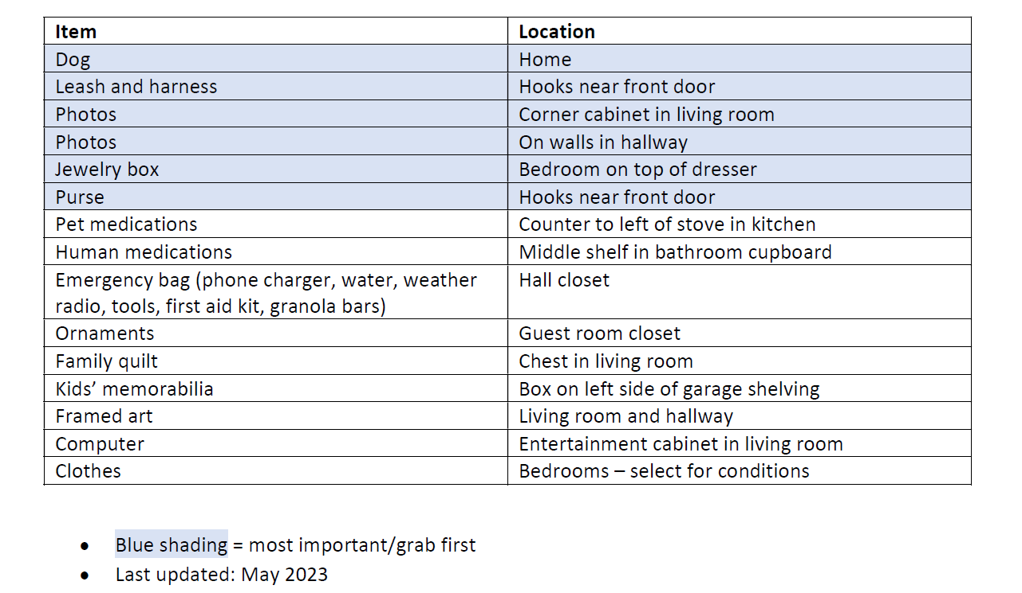
Example Grab List

Slide 35
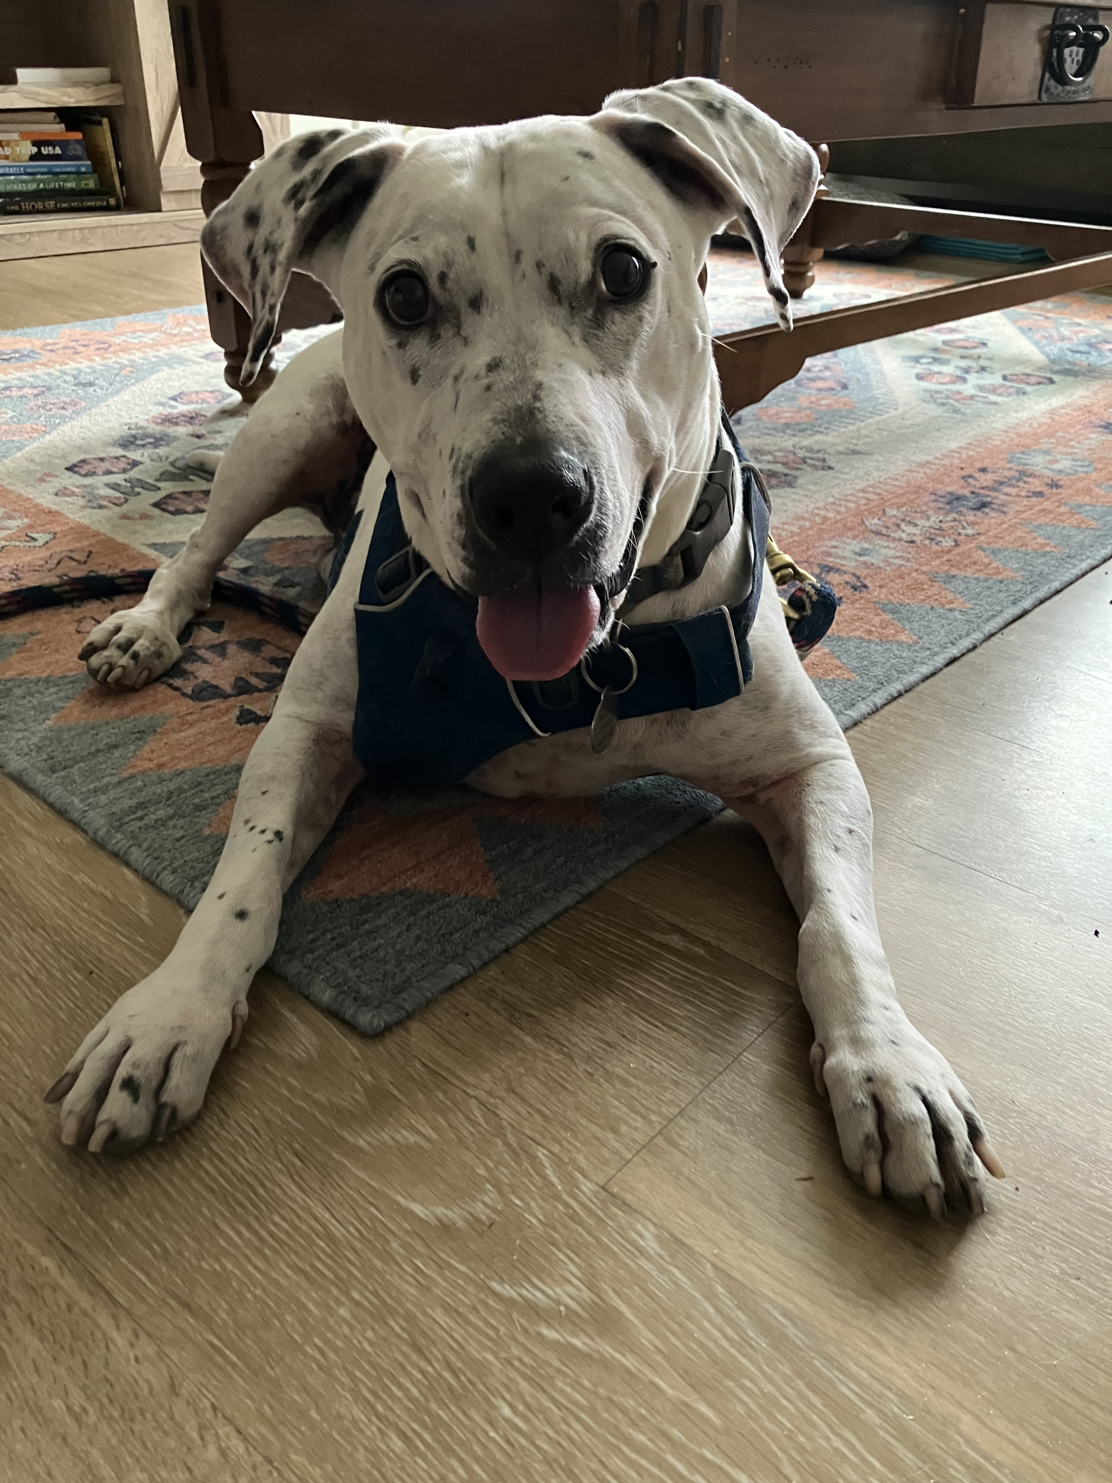
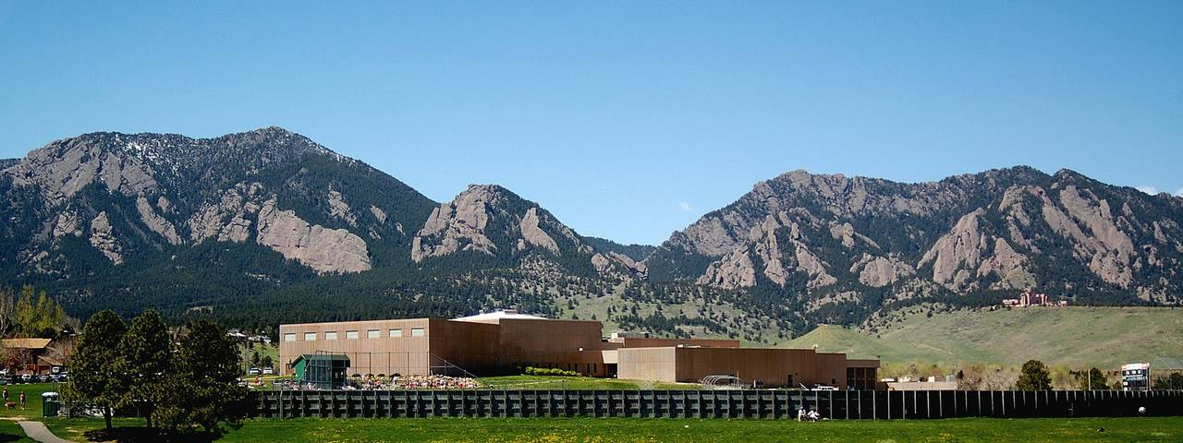
Additional Considerations
Access and functional needs
Time and place
Pets

Slide 36
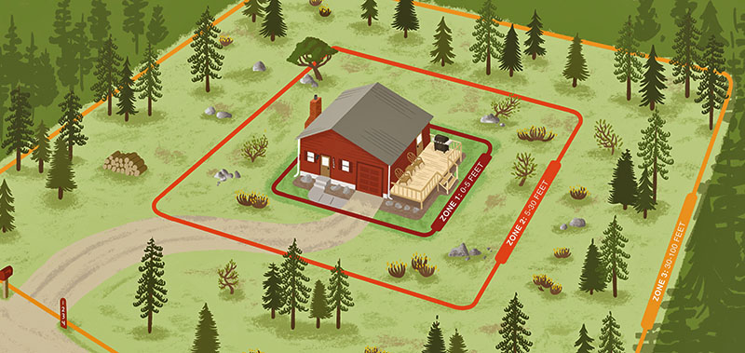
Additional Preparedness Steps
Mitigation and structure hardening
Insurance review

Slide 37
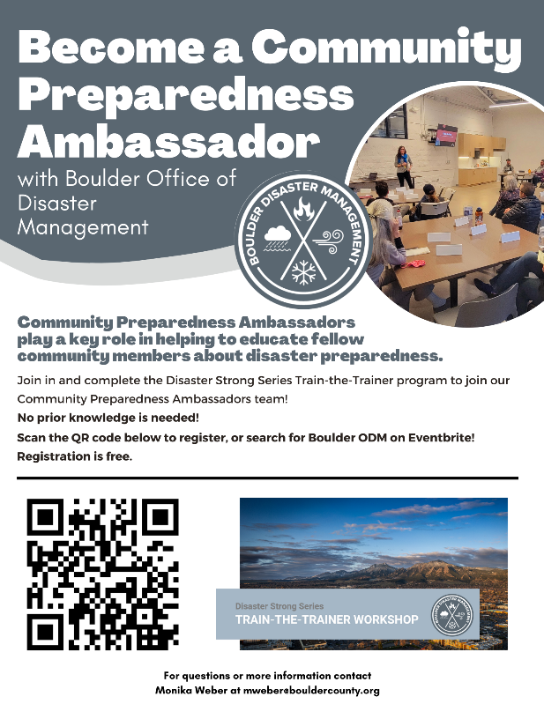
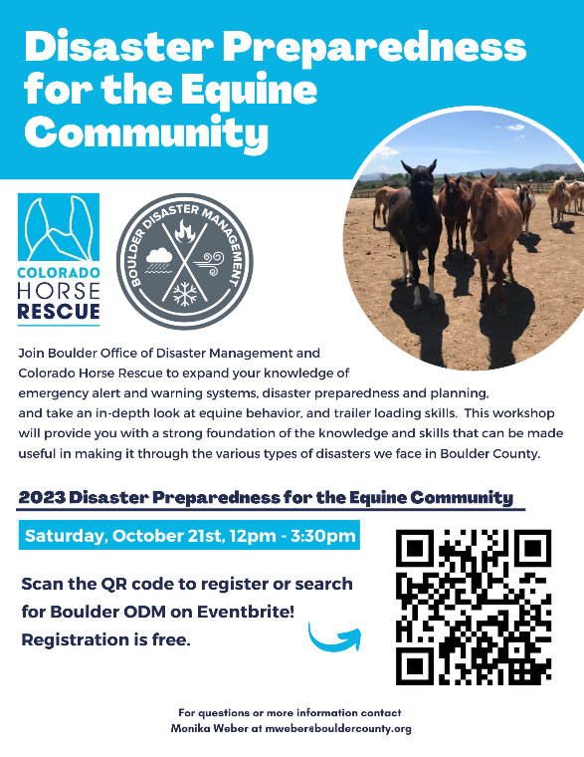
Planning and Community Resources
Boulder ODM www.boulderodm.gov/preparedness/
Wildfire Partners
Local fire departments
Fire Adapted Colorado https://fireadaptedco.org/
Disaster Strong Series events
Train-the-Trainer
Preparedness for Access and Functional Needs
Preparedness for the Equine Community

Slide 38
Thank you!
Monika Weber mweber@bouldercounty.org

Slide 39
Workshop Feedback
Notes:
This could be based on your personal experience, or your understanding of what disasters we are vulnerable to.

Slide 40
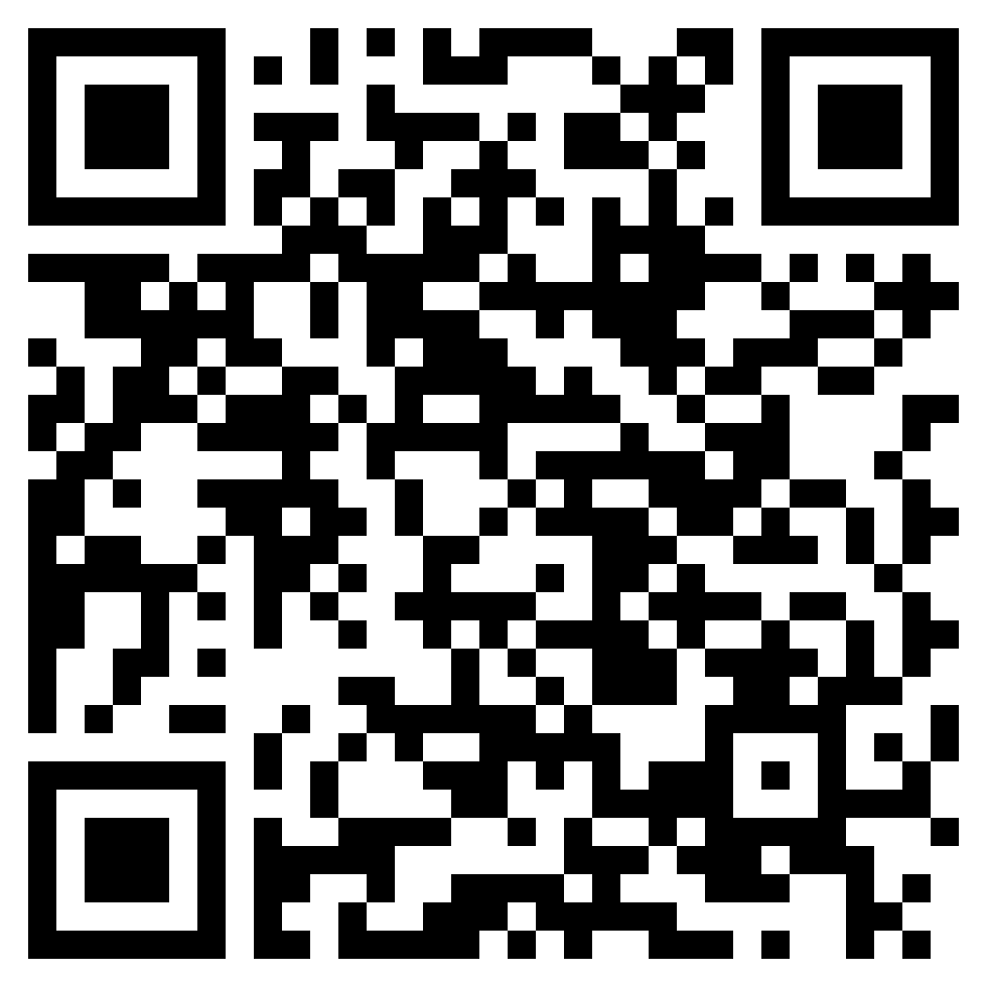
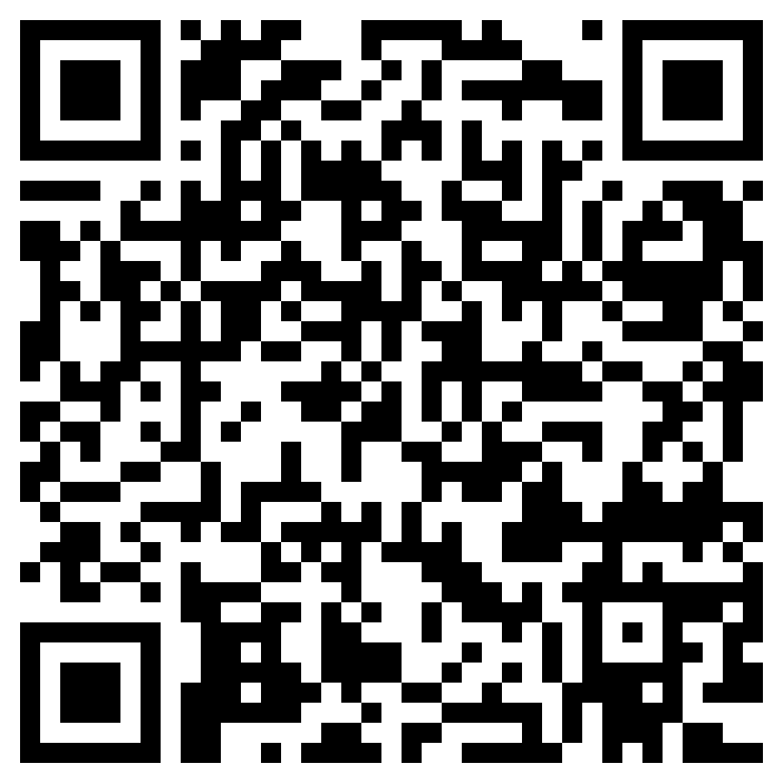
City of Boulder Community Wildfire Protection Planning
Boulder County Community Wildfire Protection Planning
Notes:
This could be based on your personal experience, or your understanding of what disasters we are vulnerable to.

